Slide 1

CAPACITY PLANNING
JACKY WANG
2022/OCT

Slide 2
Content
eCAR SYSTEM INTRODUCTION
CAPACITY PLANNING
STEPS TO CREATE CAPACITY PLANNING IN SYSTEM
STEPS TO CREATE PHASE 0/3 IN SYSTEM

Slide 3
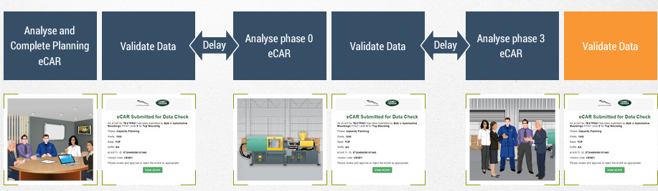
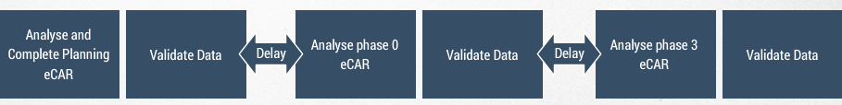
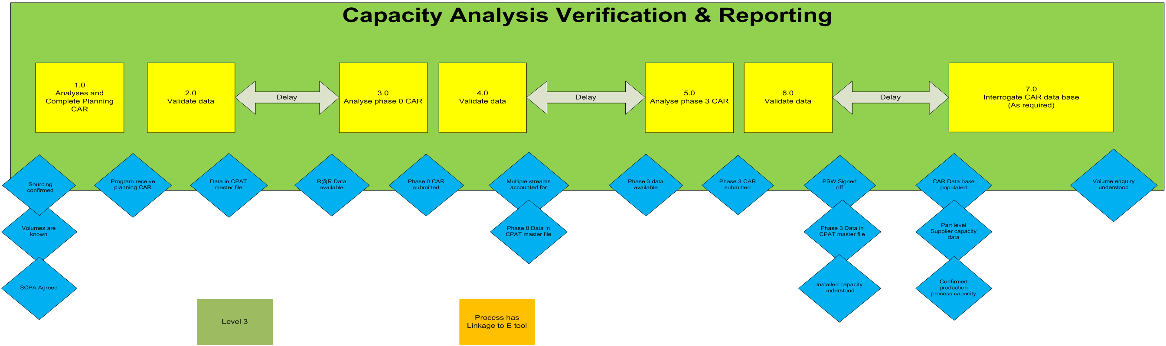
eCAR SYSTEM INTRODUCTION
6 steps for capacity analysis and report
Capacity Planning
Phase 0
Phase 3
SIPOC DIAGRAM

Slide 4




eCAR SYSTEM INTRODUCTION
Roles involved in e-car
JLR Buyer
The volumes must be the capacity planning volumes (CPV), which are based on the JLR peak weekly line rate (with flex and aftermarket).
Volumes should be at part number level and should be provided by the buyer.
Supplier
Responsible for creating eCARs
e-CAR
JLR Site STA
Responsible to on-site
check capacity and review
eCAR data.

Slide 5
eCAR SYSTEM INTRODUCTION
How to achieve a good e-car
Clear Output With Confirmed Data
Robust Planning
Support
Engaged Earlier
To Reduce Risk
Fully Understanding
JLR Requirement

Slide 6
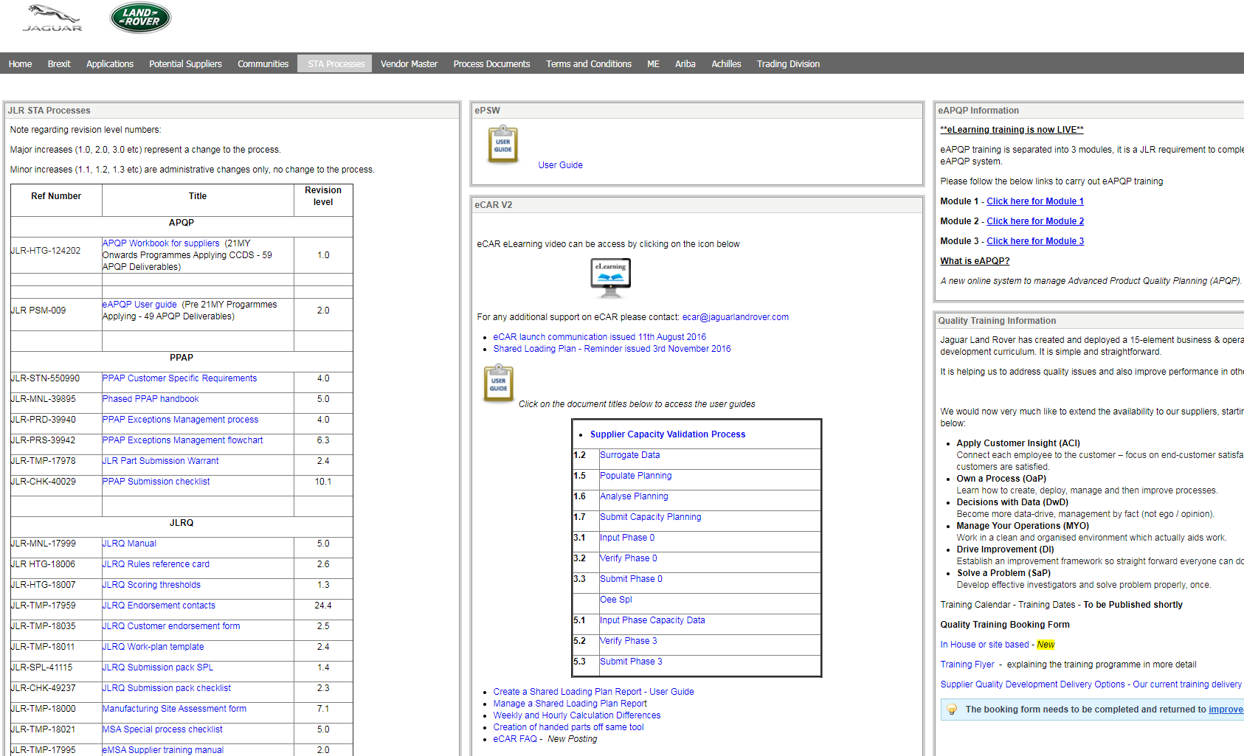
eCAR SYSTEM INTRODUCTION
E-learning on covisint
E-learning available for e-car on covisint

Slide 7
Content
eCAR SYSTEM INTRODUCTION
CAPACITY PLANNING
STEPS TO CREATE CAPACITY PLANNING IN SYSTEM
STEPS TO CREATE PHASE 0/3 IN SYSTEM

Slide 8
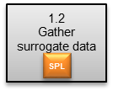
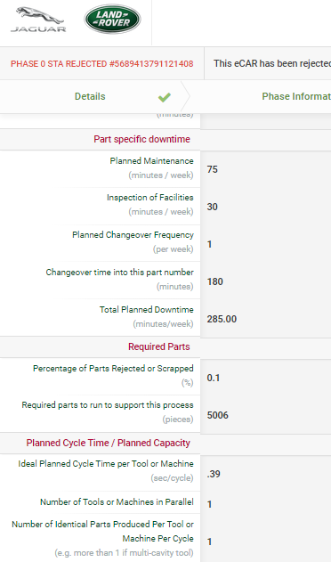
CAPACITY PLANNING
Surrogate data
When creating the initial capacity plan and associated production concept, a supplier will often use surrogate data from a similar process to estimate the:
Equipment availability
Quality Rate
Production efficiency
The validity of this data needs to be critiqued to ensure it is appropriate and will therefore be a good prediction of delivered capacity.
Main things to consider:
Is the design giving the equivalent process steps?
What is the latest actual steady state performance?
Has the process technology changed and what are the implications?
Ideally, the supplier should be able to demonstrate the building block via Methods-Time Measurement (MTM), or other predetermined motion time system that is to analyse the methods used to perform any manual operation or task and, as a product of that analysis, set the standard time in which a worker should complete that task.

Slide 9
Content
eCAR SYSTEM INTRODUCTION
CAPACITY PLANNING
STEPS TO CREATE CAPACITY PLANNING IN SYSTEM
STEPS TO CREATE PHASE 0/3 IN SYSTEM

Slide 10
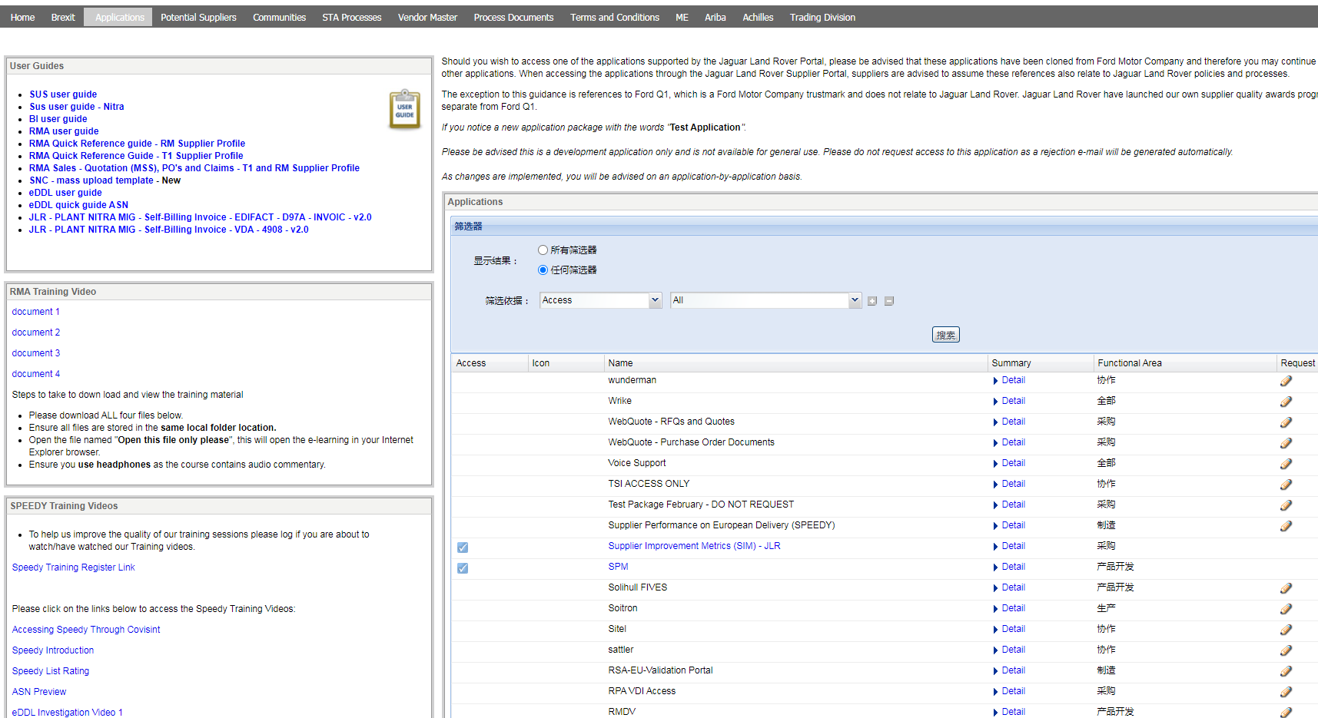
STEPS TO CREATE CAPACITY PLANNING IN SYSTEM
CONVISINT - APPLICATION
Click application
STEP 1

Slide 11
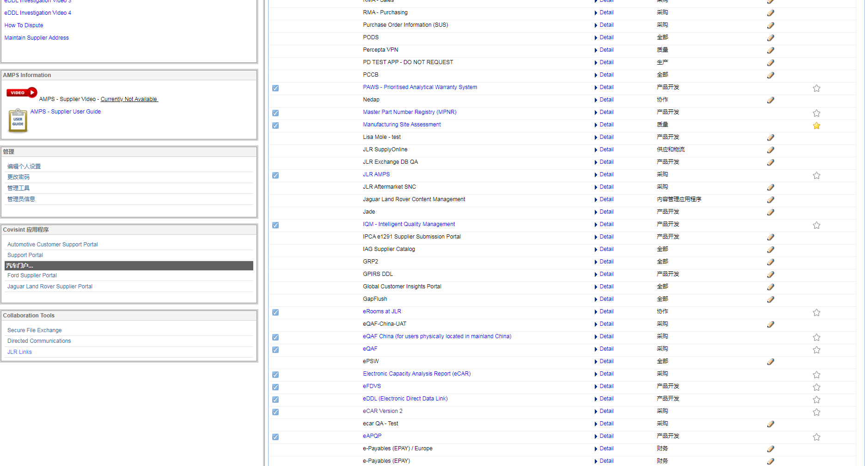
STEPS TO CREATE CAPACITY PLANNING IN SYSTEM
E-CAR REVISION 2
Click eCAR link
STEP 2
Make sure ‘eCAR Revision 2’ link is at edited status

Slide 12
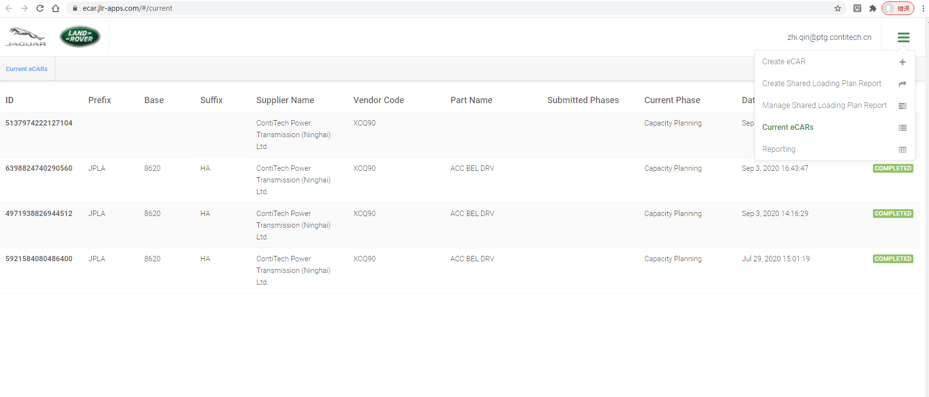
STEPS TO CREATE CAPACITY PLANNING IN SYSTEM
Create e-car
STEP 3

Slide 13
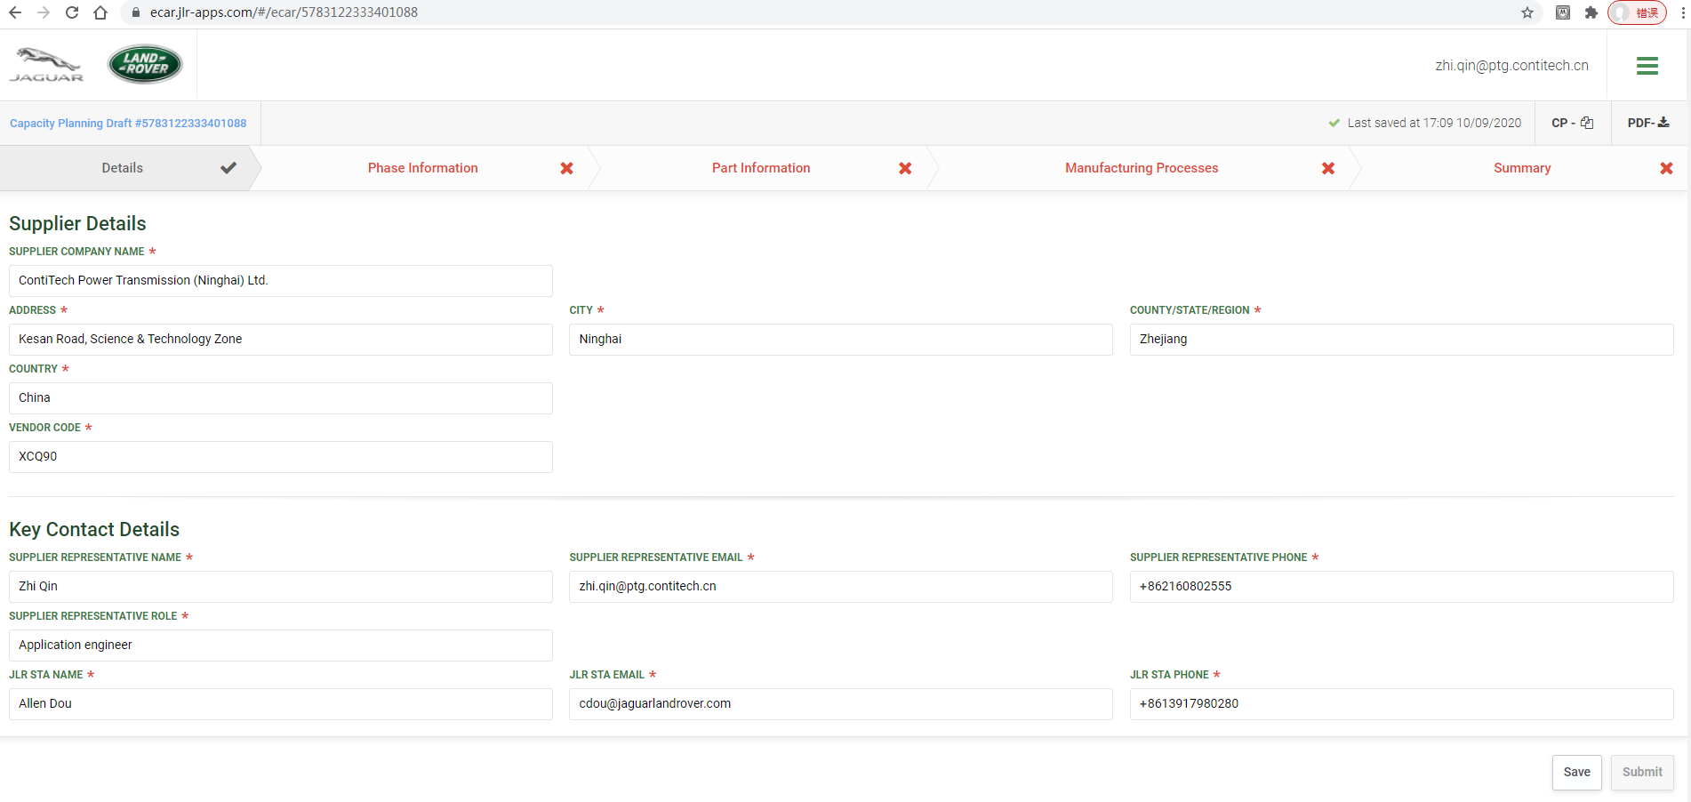
STEPS TO CREATE CAPACITY PLANNING IN SYSTEM
Capacity planning - details
STEP 4
Note: PPAP Level 1 suppliers the JLR STA EMAIL address is ecarlev1@jaguarlandrover.com
Only STA with L2P can be filled in

Slide 14
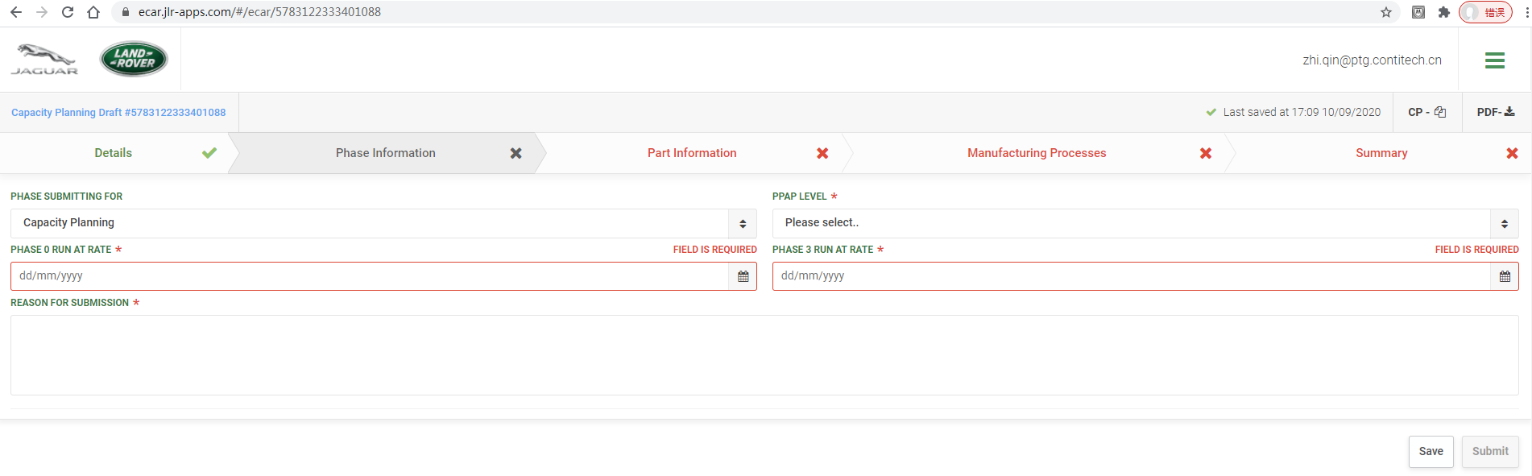
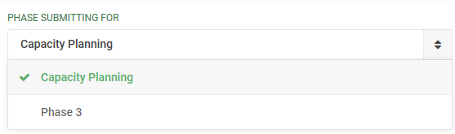
STEPS TO CREATE CAPACITY PLANNING IN SYSTEM
Capacity planning – phase information
STEP 5
Note: Phase 0 and Phase 3 run at rate date cannot be in the past/ today

Slide 15
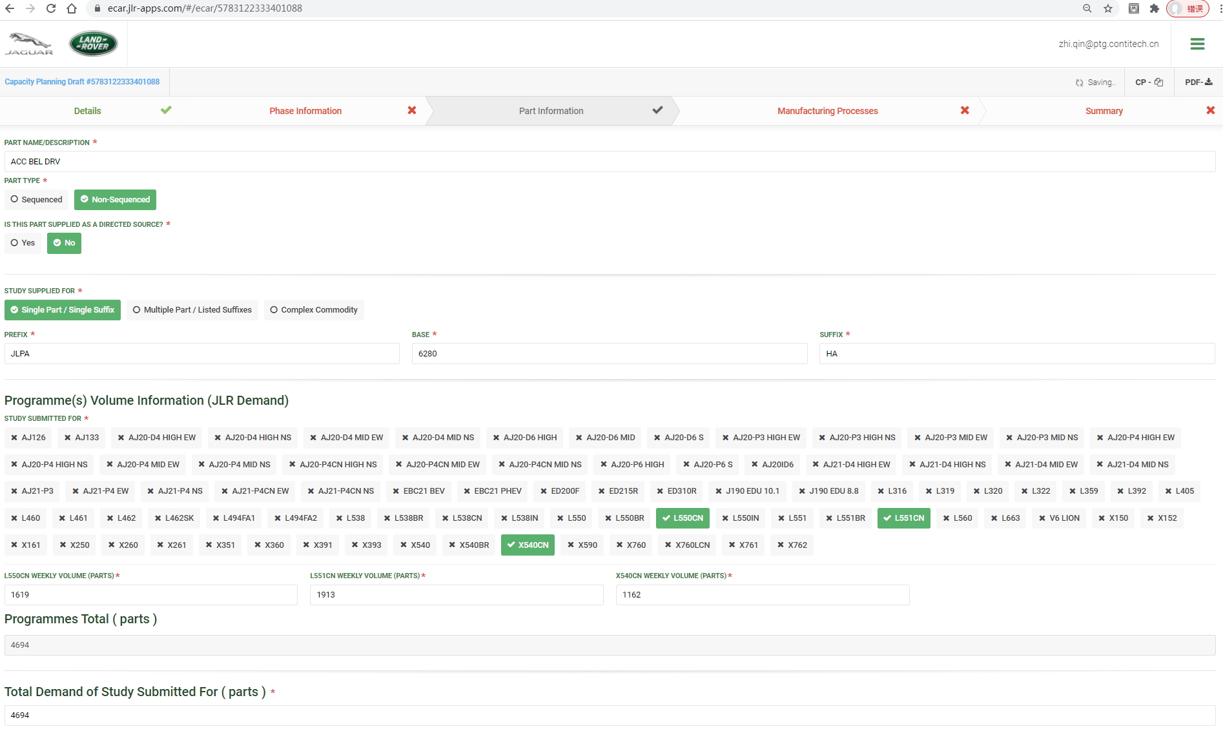
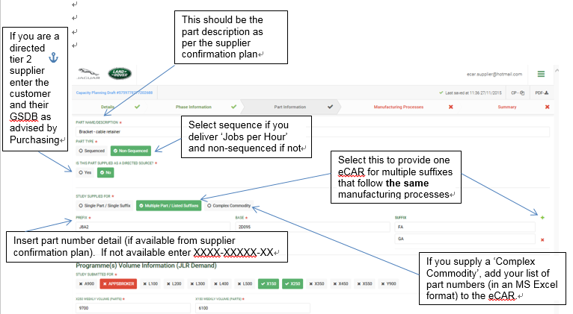
STEPS TO CREATE CAPACITY PLANNING IN SYSTEM
Capacity planning – part information
STEP 6

Slide 16
STEPS TO CREATE CAPACITY PLANNING IN SYSTEM
Capacity planning – part information
STEP 6
Note: JLR Demand must check SCPA!
Insert part number detail (if available from supplier confirmation plan). If not available enter XXXX-XXXXX-XX

Slide 17
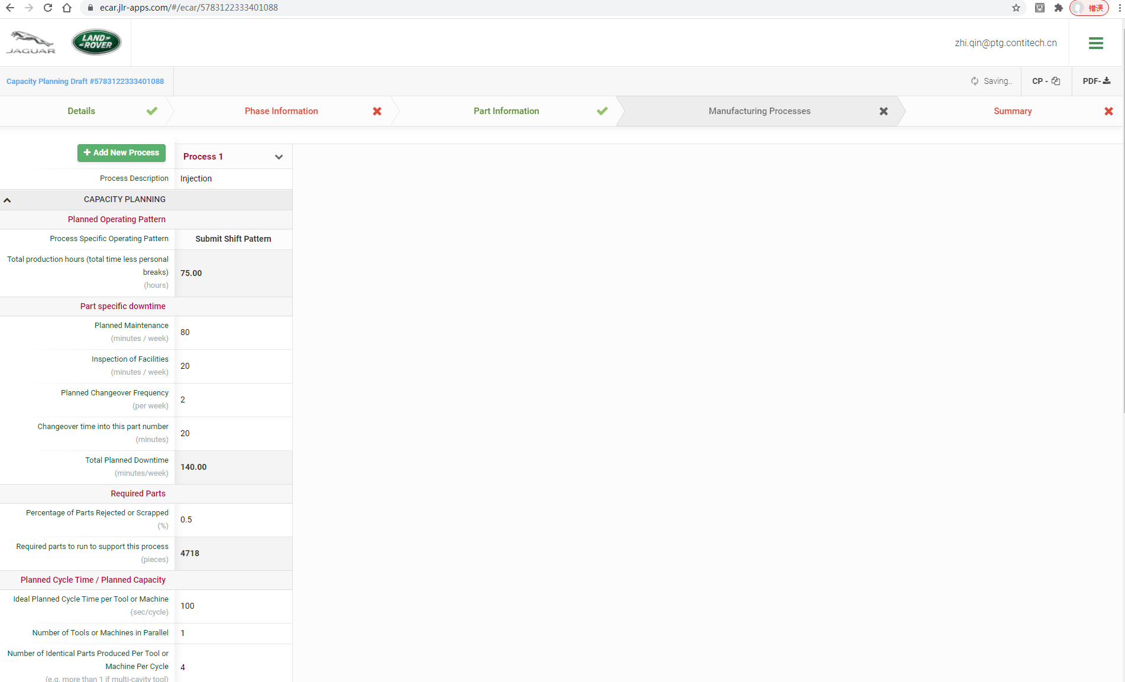
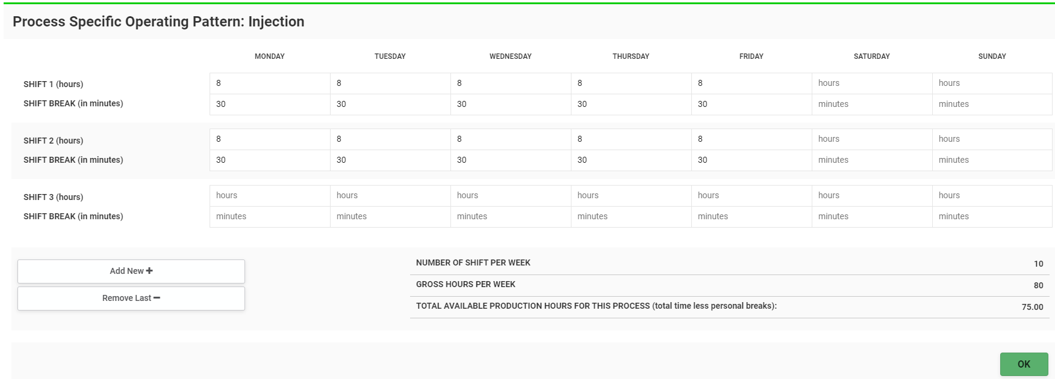
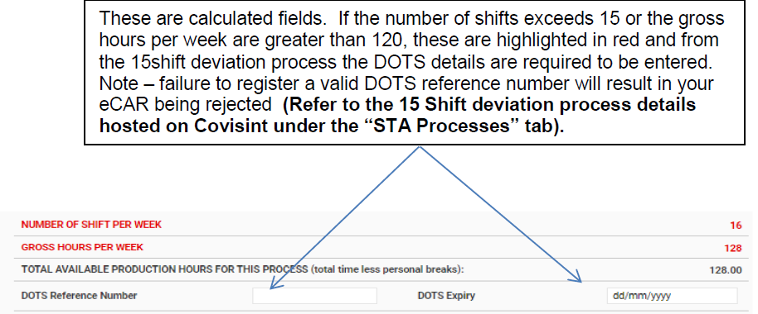
STEPS TO CREATE CAPACITY PLANNING IN SYSTEM
Capacity planning – manufacturing processes
STEP 7
Deviation need if more than15 shift or 120 hours per week

Slide 18
STEPS TO CREATE CAPACITY PLANNING IN SYSTEM
Capacity planning – manufacturing processes
STEP 7
Enter planned maintenance time per shift
Total time Available= 10 shift *8 h*60 min= 4800 min
Planned breaks= 10 shift *30 min=300 min
Total production hours= Total time available- planned breaks= 4500min= 75h
Enter the amount of time required for inspections / adjustments to the process per week
Enter the frequency of changeover required per week (different to previous CAR process)
Equipment availability
Planned Downtime= Planned maintenance+ Inspection of Facilities+ Planned changeover Frequency* Change over time= 80+20+2*20=140 min
Enter the amount of time required per tool changeover
Enter the projected reject rate for this process
Quality Rate
Required parts to run= 4694/(1-0.5%)=4718
Enter the best estimate of planned net ideal cycle time for this process
Production efficiency

Slide 19
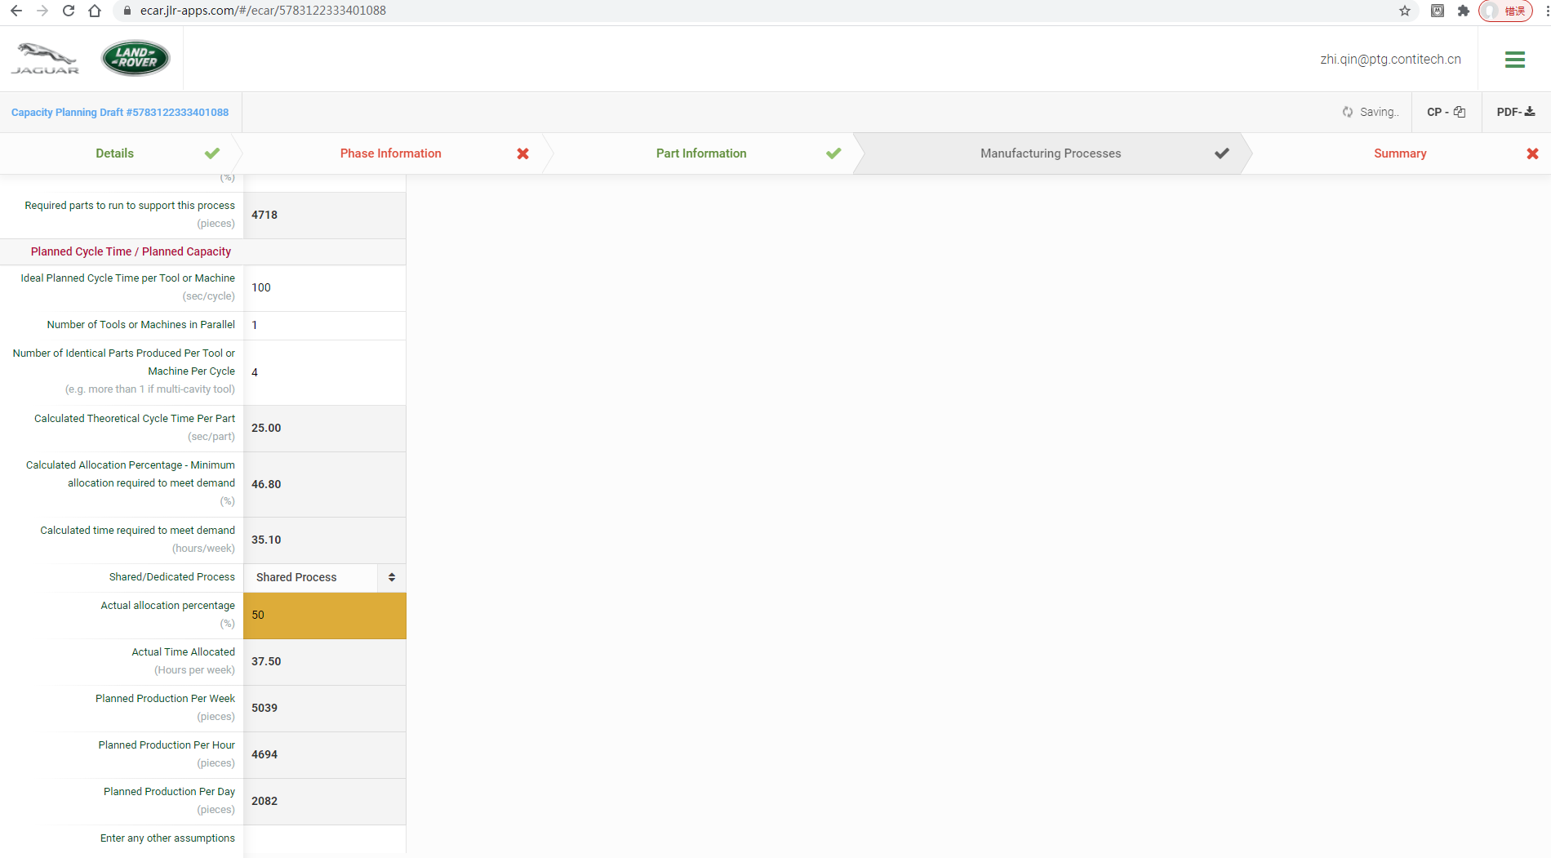
STEPS TO CREATE CAPACITY PLANNING IN SYSTEM
Capacity planning – manufacturing processes
STEP 7
This cell will remain amber if process is identified as being shared.
Minimum allocation percentage required to meet demand= calculated time required/total production hours=35.1/75=46.8%
…then the default allocation is based on the previous calculation.
This can be over typed with the actual allocation (if different), and all subsequent calculations will be based on this.
Calculated time required to meet demand= Calculated theoretical cycle time per part* Required parts+ planned downtime=25s*4718/3600+ 140 min/ 60=35.1 h
Actual allocation percentage must >= minimum allocation required percentage
Actual Time allocated=actual allocation percentage* total production hours= 50%* 75= 37.5h

Slide 20
STEPS TO CREATE CAPACITY PLANNING IN SYSTEM
Capacity planning – manufacturing processes
STEP 7
All grey cells are auto calculations.
Sequence suppliers: refer to ‘Per Hour’.
Non-sequence refer to ‘Per Week’.
Planned Production Per week= (Actual Time allocated- planned downtime)/ Calculated Theoretical Cycle time per part*(1- percentage of reject or scrap )= (37.5*3600-140*60)/25*(1-0.5%) =5039
Free text box to advise any assumptions you may have made in generating this data

Slide 21
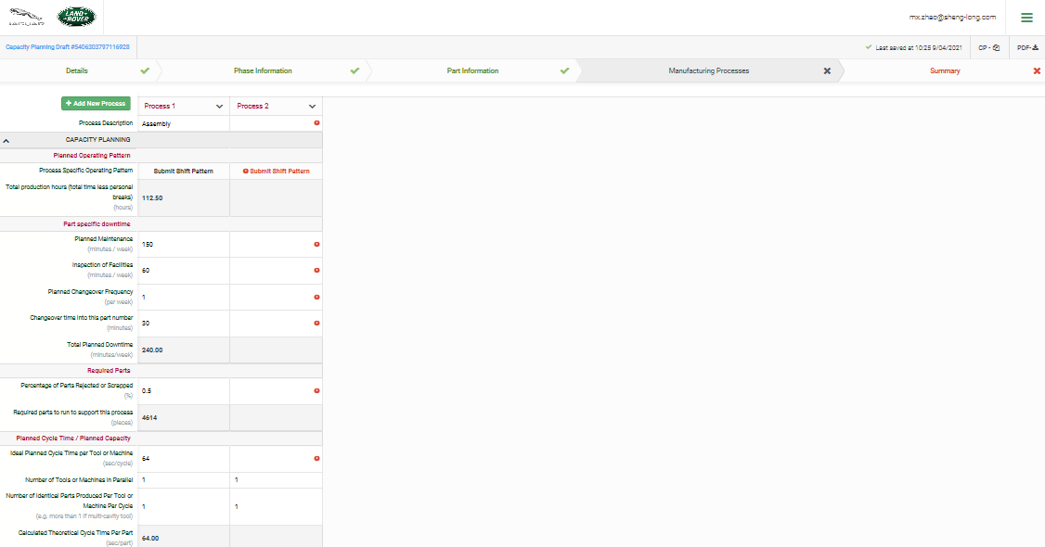
STEPS TO CREATE CAPACITY PLANNING IN SYSTEM
Capacity planning – manufacturing processes
Add New Processes
STEP 7

Slide 22
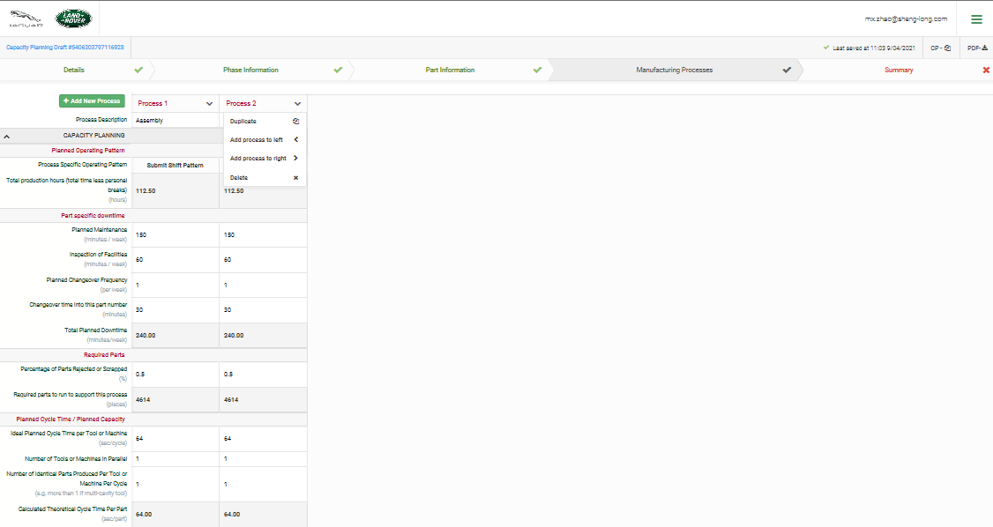
STEPS TO CREATE CAPACITY PLANNING IN SYSTEM
Capacity planning – manufacturing processes
STEP 7
Duplicate or Delete Process

Slide 23
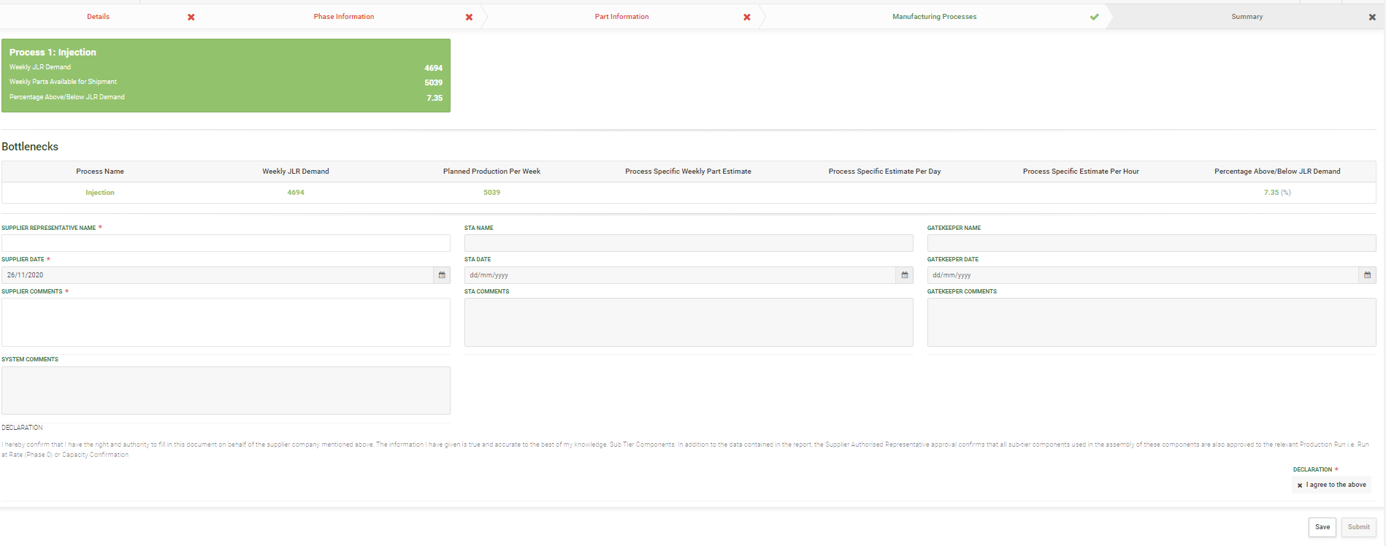
STEPS TO CREATE CAPACITY PLANNING IN SYSTEM
Capacity planning - summary
STEP 8
Weekly demand meets requirement
Complete all the information, and agree ‘DECLARATION’, then click "submit”

Slide 24
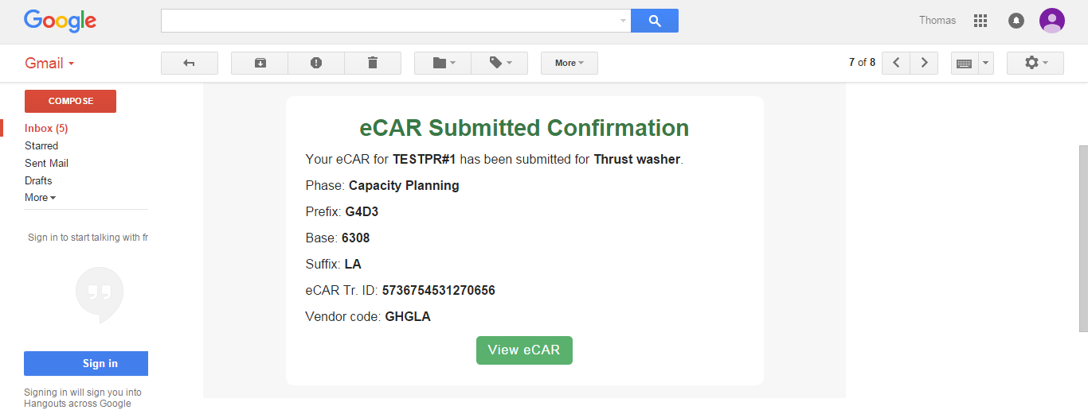
STEPS TO CREATE CAPACITY PLANNING IN SYSTEM
Capacity planning
On submitting the Capacity Planning eCAR to JLR, the supplier will receive an email similar to the following:
Note: STA will receive a similar email notification that a Capacity Planning Phase eCAR has been submitted. Using the View eCAR link, the STA can review the details of the eCAR, no edits can be made and no approval is required.

Slide 25
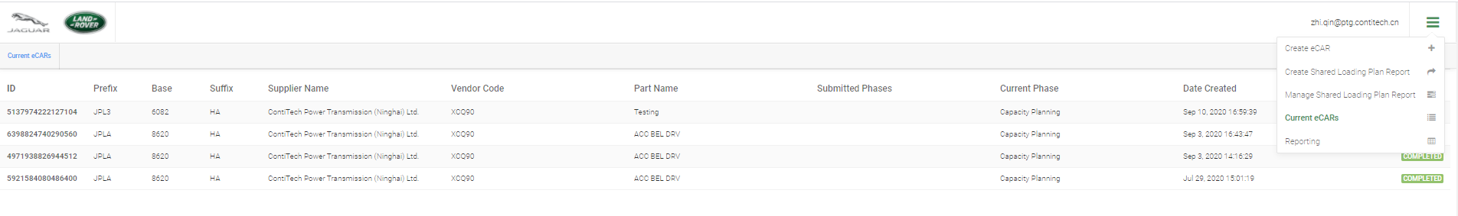
STEPS TO CREATE CAPACITY PLANNING IN SYSTEM
Capacity planning
Once STA approved capacity planning (or system approve it automatically), supplier can view the approved capacity Planning in eCAR system, just as following,
Click here

Slide 26
Content
eCAR SYSTEM INTRODUCTION
CAPACITY PLANNING
STEPS TO CREATE CAPACITY PLANNING IN SYSTEM
STEPS TO CREATE PHASE 0/3 IN SYSTEM

Slide 27
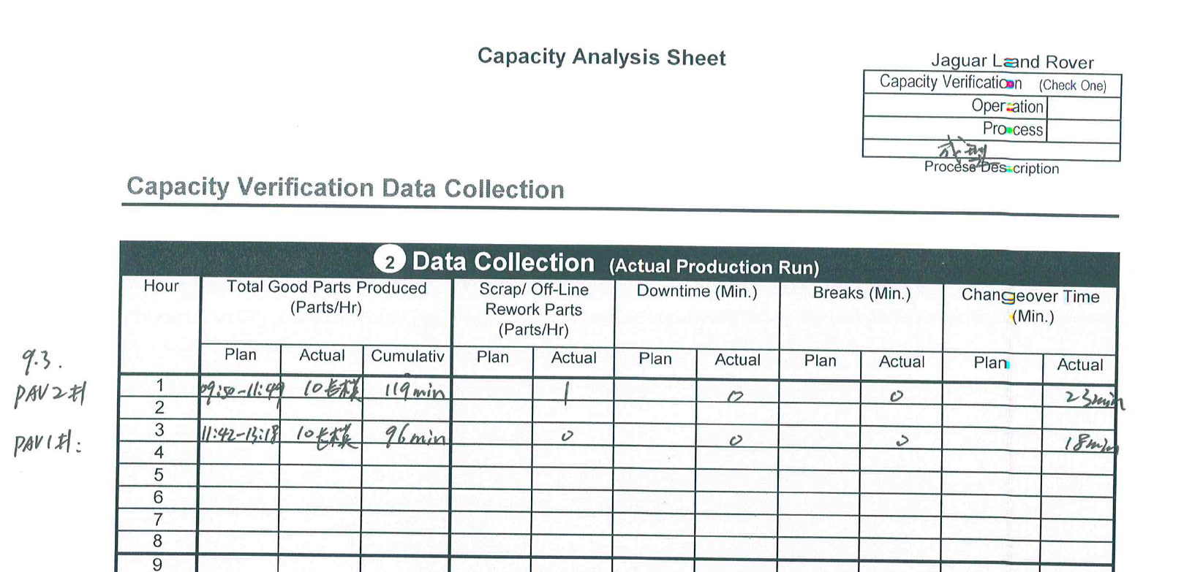
STEPS TO CREATE PHASE 0/3 IN SYSTEM
Data collection plan prior phase 0/3
Supplier needs to make data collection plan prior phase 0/3, and it’s better to review this plan with STA in advance.
Supplier follows data collection plan to run phase 0/3, and gather data.
Once supplier data collection complete, supplier is able to log in eCAR system, and open the related capacity planning, and fill in actual phase 0/3 data.
Example of data collection sheet for phase 0/3

Slide 28
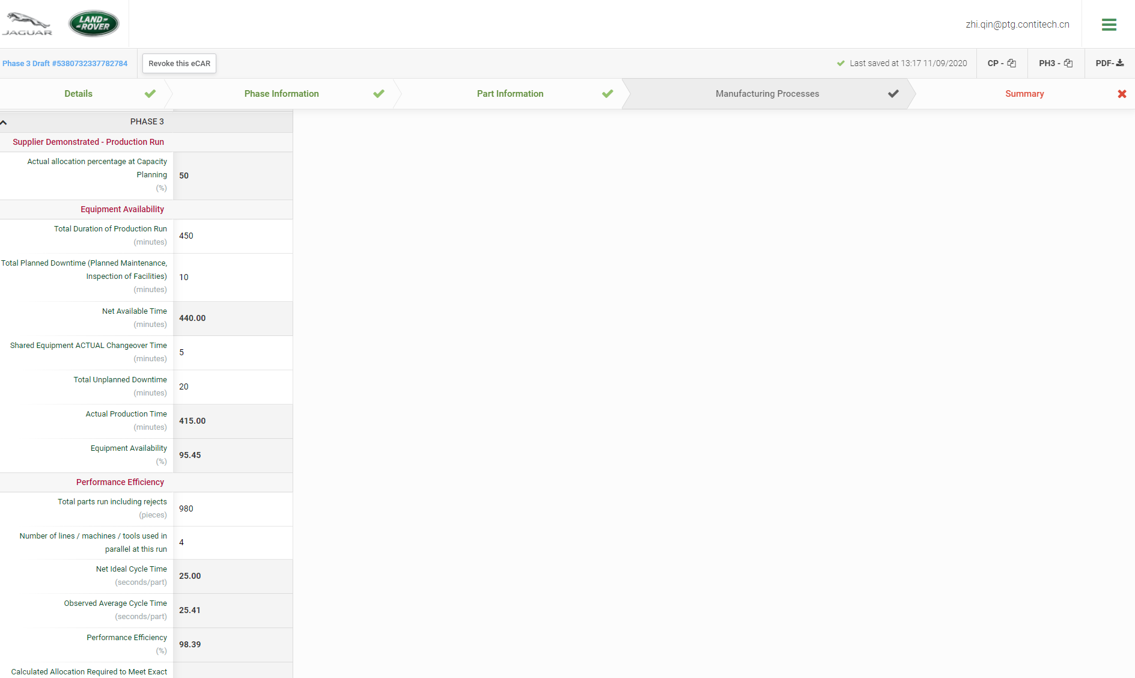
STEPS TO CREATE PHASE 0/3 IN SYSTEM
Phase 0/3 equipment availability
Complete phase 0/3 equipment availability data input.
Fill in actual data for equipment availability
Actual Production Time= Total Duration of Production Run_ total Planned Downtime- Shared Equipment Actual changeover Time- Total Unplanned Downtime=450-10-5-20=415min

Slide 29
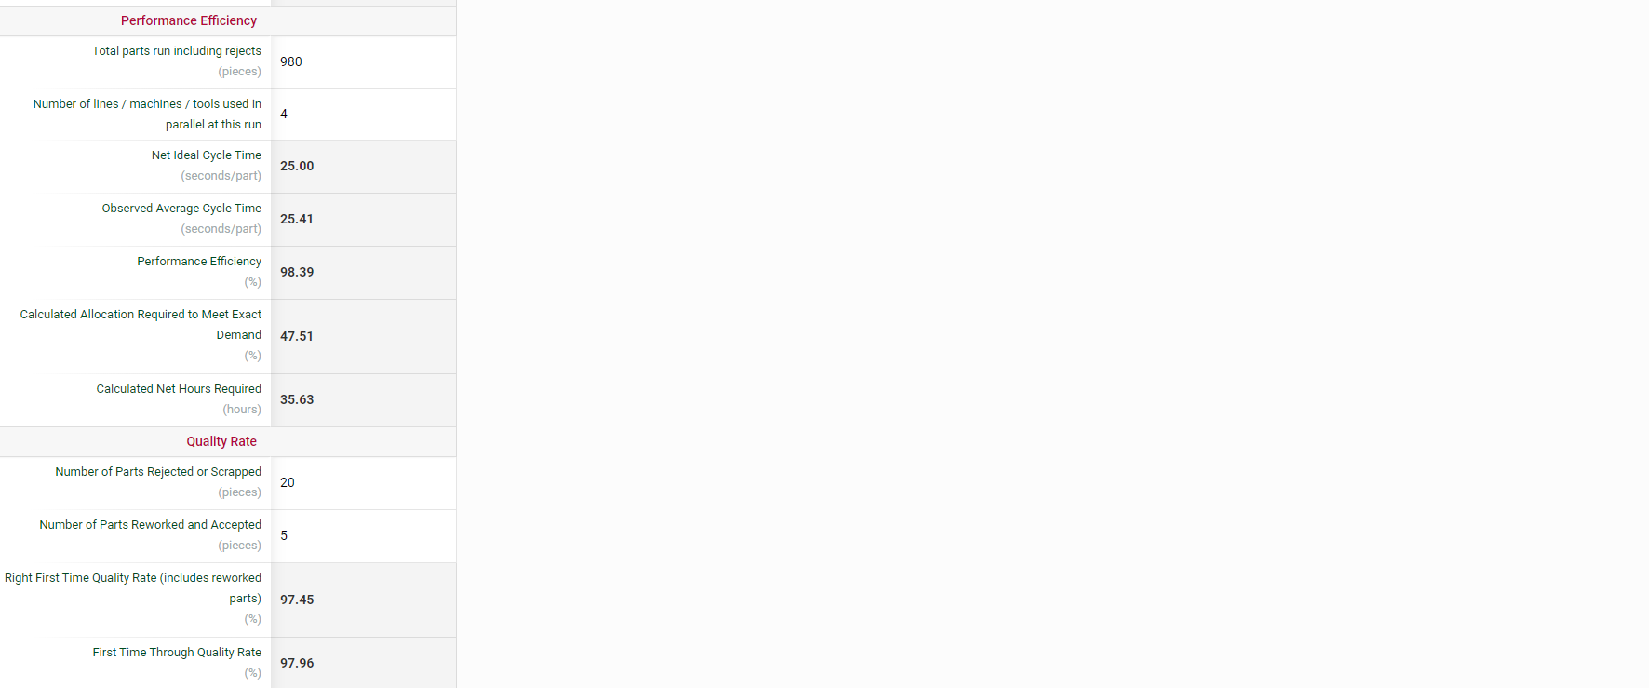
STEPS TO CREATE PHASE 0/3 IN SYSTEM
Phase 0/3 performance efficiency & quality rate
Complete phase 0/3 production performance and quality rate data input.
Fill in actual data for performance and quality rate
Observed Average Cycle Time= Actual Production time/total parts run including rejects=415min*60/980=25.41s
Performance Efficiency=Total parts run including rejects/ Theoretical parts should produce=980/(415min*60/25s)=98.39%
Calculated time Net Hours Required= Observed Average cycle time * Required parts+ planned downtime=25.41s*4718/3600+ 140 min/ 60=35.63 h
Calculated Allocation Required to Meet Exact Demand= Calculated time Net Hours Required/Total production hours=35.63/75=47.51%
RFT Quality Rate=(total parts run-scrapped- reworked)/total parts run=(980-20-5)/980=97.45%
FTT Quality Rate=(total parts run-scrapped)/total parts run=(980-20)/980=97.96%

Slide 30
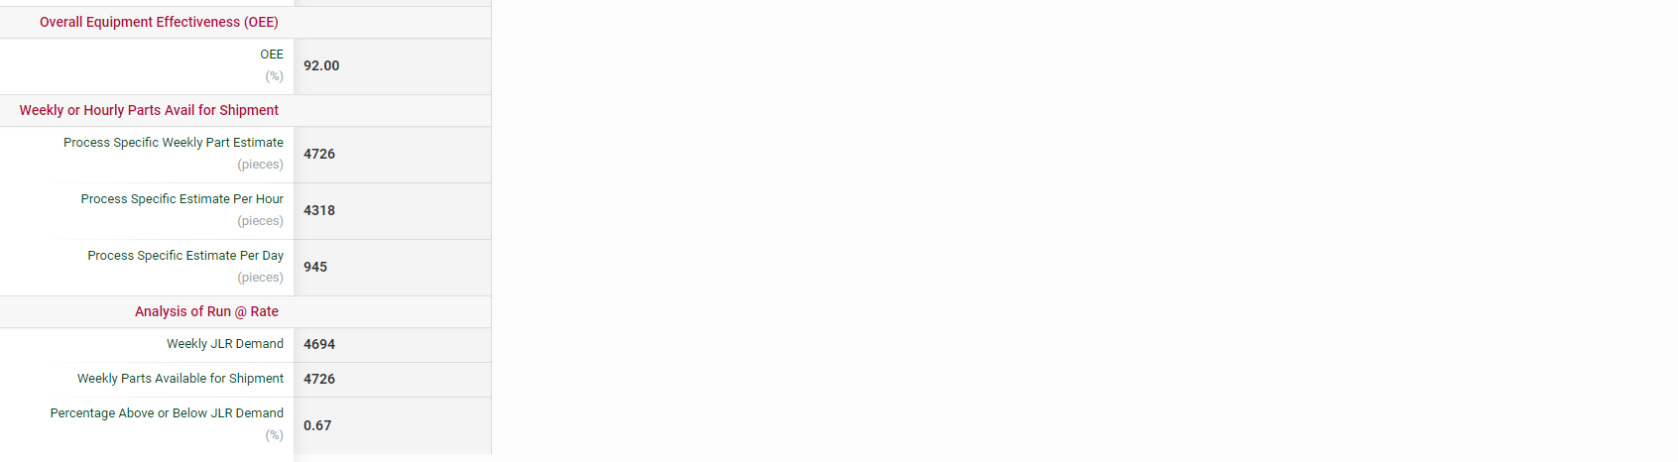
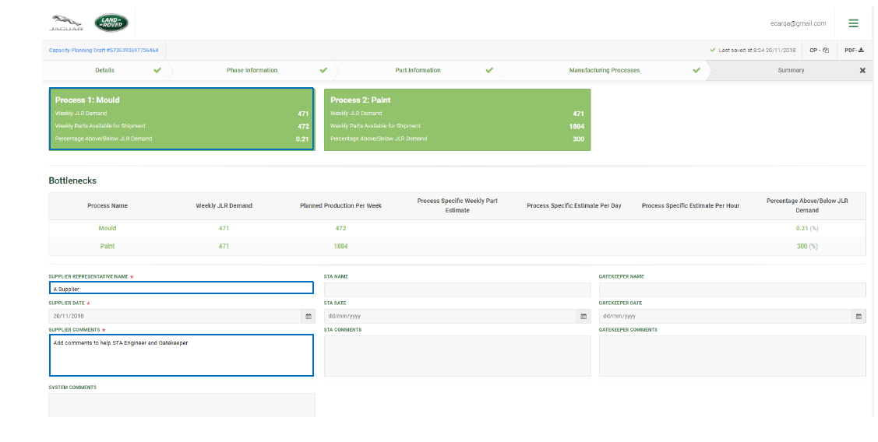
STEPS TO CREATE PHASE 0/3 IN SYSTEM
Phase 0/3 oEE and Run@rate
OEE= Equipment Availability*Performance Efficiency*FTT Quality Rate=95.45%*98.39%*97.96%=92%
Supplier submission

Slide 31
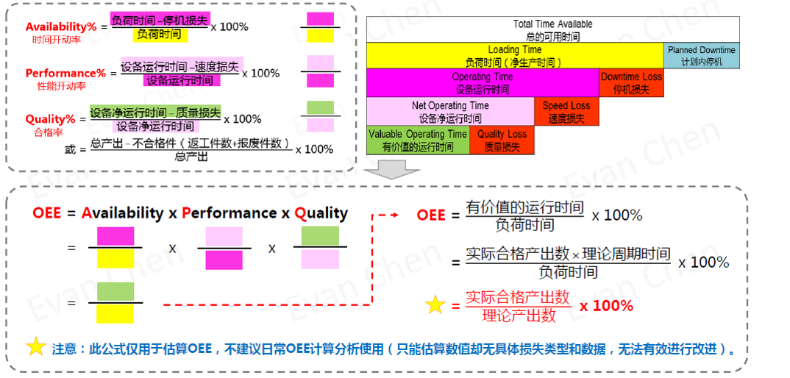
STEPS TO CREATE PHASE 0/3 IN SYSTEM
oEE calculation

Slide 32
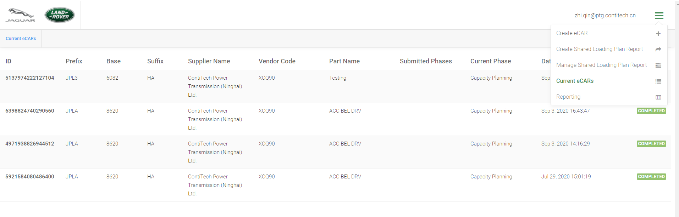
STEPS TO CREATE PHASE 0/3 IN SYSTEM
Shared loading plan
Share loading plan / lessons learning training by Louis Jiang

Slide 33


