Slide 1

Value Stream Mapping
Awareness and Interpretation FOR procurement
James Underwood
16/01/2023
Notes:
Select one of these pre-defined front pages and delete the rest. This document will be updated regularly to ensure product images are current.
Please note that for all internal presentations you must use the dual brand template, even if your content is single brand. Only use the single brand template
for external presentations, product launches or brand immersion events.

Slide 2
SBR PROCESS
In the new release of the process “Sourcing for Quality” JLR now mandates either a Process Flow Diagram or a Value stream Map is supplied as supportive evidence to quotation.
SAP Ariba now requires the buyer to confirm receipt and that it contains the right information to support a quotation advance in GSP.

Slide 3
VSM vs QAF vs eQAF vs Planning eCAR
The Table below compares the sourcing document information inputs and what can be found where to ensure consistency of data is observed for cross reference. As you will note the VSM should contain all of the relevant data needed to ensure costs are transparent.
 | VSM | QAF | eQAF | Planning eCAR
Process Flow | * | * | *
Cycle time | * | * | * | *
# of Operators | * | * | * | *
Parts x cycle | * | * | * | *
Scrap rate | * | * | * | *
OEE -Availability -Performance -Quality (Scrap) | * * | * Combined (availability and performance) * | * | * * *
Shift pattern | * |  |  | *
Batch size | *
Change over | * |  |  | *

Slide 4
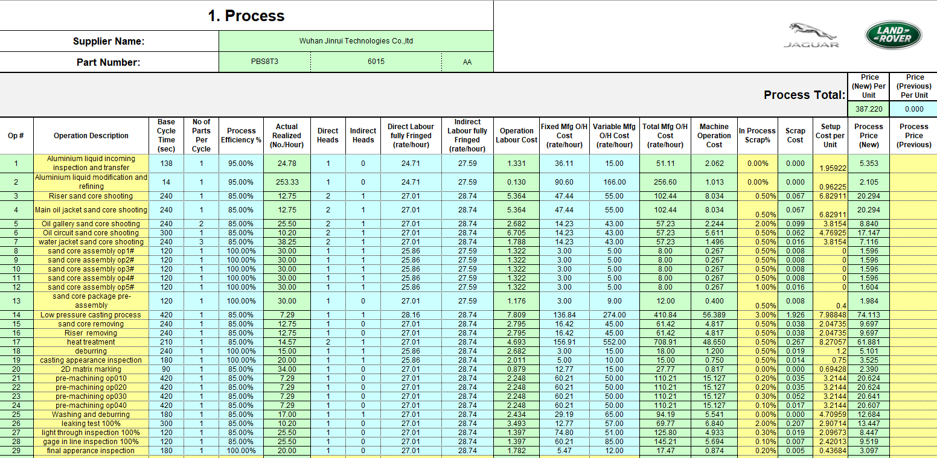
QAF VS VSM
Key Information
VSM INFORMATION
Process flow
Cycle Time
No of Operators
Parts per cycle
Scrap Rate
OEE (3 Elements)
Shift Pattern
Batch Size **
Change Over **
Jobs per hour can be calculated using CT and the Parts per cycle.
JIT vs non JIT
QAF
#/Name of Operations
Cycle time
Parts x cycle
# Operators
Scrap rate
OEE (efficiency)
Notes:
Note: how is the cost per set up and the change over.
Interrogate how the set up cost per unit was calculated (identify how this is done). Machine rate

Slide 5
eQAF VS VSM
EFFICIENCY IMPROVEMENTS
Current State
eQAF
#/Name of Operations
Cycle time
Parts x cycle
# Operators
OEE (efficiency)
Scrap rate
77% Process Efficiency including an Average Machine Stoppage of 10 mins every 2 hours
2 Hour Tool Changeover = €0.276 per part
5% Scrap Rate = €0.057 per part
Notes:
Introduction (tell you what I’m going to tell you)
As an example we have an injection moulded component
Detail (tell you)
Currently the machine tends to breakdown or stop 40 minutes every shift . An average of about 10 mins every 2 hours. i.e. Insert pin auto feed blockage. Robot gripper not unloading properly. Short shots etc.
When we do a changeover, it takes 2 hours from last good part to first good part
And our scrap rate is running at 5% which is about 4 parts per hour
Summary (tell you what I told you)
So what could happen if we employ some TPM, SMED and Poka Yoke techniques
Next Slide

Slide 6
Purpose of VSM
wHAT
Value-stream mapping, also known as "material- and information-flow mapping",is a lean-management method for analyzing the current state and designing a future state for the series of events that take a product or service from the beginning of the specific process until it reaches the customer. A value stream map is a visual tool that displays all critical steps in a specific process and easily quantifies the time and volume taken at each stage. Value stream maps show the flow of both materials and information as they progress through the process.
There are three kinds of value stream maps, proposed, current state (as implemented) and future state (with productivity improvements). The current state value stream map is used to determine what the process currently looks like, the future state value stream map focuses on what the process will ideally look like after process improvements have occurred to the value stream.
In this presentation we will only consider
Proposed State
Tier 1 Factory Boundary Consideration only
Notes:
Titles – JLR EMERIC SEMI BOLD 18pt – ALL CAPS
Subtitles – JLR EMERIC 18pt – ALL CAPS
Body copy – JLR Emeric ExtraLight 16pt – sentence case

Slide 7
Objectives and agenda
Purpose: Clarify what a Value Stream Map (VSM) is and learn how to read it
Objectives: Provide common understanding of Value Stream Map
Outcome: Ability to read a Value Stream Map
Agenda:
1. Introductions
2. What is a Value Stream Map?
a. Customer loop
b. Suppliers loop
c. Processes within plant
d. Lead time
3. “Push” vs “Pull” – differences

Slide 8
Is / Is not
Level 0 - What is a Value Stream Map (VSM) and how to read it?
IS:
- Basic understanding of elements of the VSM
IS NOT:
- Training on Lean principles or assessing the manufacturing concept / strategy
- Training on how to create a VSM or lead a team to create a VSM

Slide 9
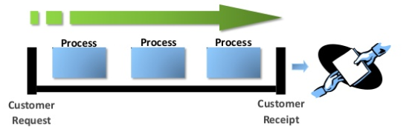
What is a Value Stream?
Value Stream – all the actions (both value added, and non-value added) currently required to transform a customer request into a good or service (i.e., the production flow from raw material into the arms of the customer)
Notes:
Ask questions to delegates to gauge their understanding

Slide 10
What is a Value Stream Map?
Value Stream Map – a technique / tool used to understand and document the flow of material and information as a product makes its way through a value stream
Supplier
Customer
Demand/month:
Weekly: 6522
Part A =
Planning
Logistics
Part A = 4239
Part B =
6 months Flexi EDI
6 months Flexi EDI
Part B = 1630
Part C =
1 week fixed EDI
1 week fixed EDI
Part C = 652
# of shifts =
# of shifts = 3
2 x/
week
Daily build schedule
2 x/
day
I
Fork Truck
I
6 Tns
3 Coils
Stamping
I
Welding
I
Assembly
I
Shipping
120 A
50 B
150 C
Fork Truck
C/T = 63 secs
C/O = 60 mins
Uptime = 100%
Scrap = 5%
Op / Shift = 1 / 3
150 A
100 B
100 C
C/T = 73 secs
C/O = 20 mins
Uptime = 95%
Scrap = 2%
Op / Shift = 1 / 3
1000 A
800 B
100 C
C/T = 110 secs
C/O = 60 secs
Uptime = 95%
Scrap = 8%
Op / Shift = 4 / 3
500 A
200 B
50 C
C/T = 40 secs
C/O = 10 secs
Uptime = 100%
Scrap = 0%
Op / Shift = 2 / 3
Fork Truck
5 Days
63 seconds
0.27 Day
73 seconds
2.07 Days
110 seconds
0.58 Day
40 seconds
0.25 Day
Notes:
* “Learning to See” by Mark Rother and John Shook
- Ask questions to delegates to gauge the understanding

Slide 11
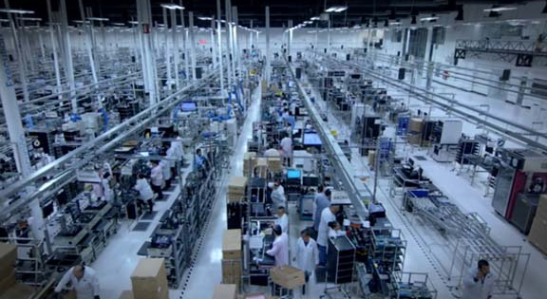
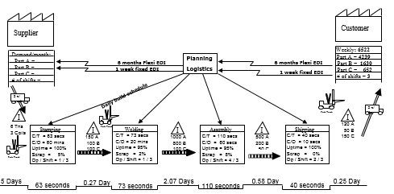
Why do we use a Value Stream Map?
Benefits of VSM*
Notes:
* “Learning to See” by Mike Rother and John Shook

Slide 12
Why do we use a Value Stream Map?
Benefits of VSM*
It helps to visualise more than just the single process i.e. assembly, welding, etc. in production; you can see the flow.
It provides a common language for talking about manufacturing process.
Notes:
* “Learning to See” by Mike Rother and John Shook

Slide 13
Why do we use a Value Stream Map?
Benefits of VSM*
It helps to visualise more than just the single process i.e. assembly, welding, etc. in production; you can see the flow.
It provides a common language for talking about manufacturing process.
It helps to see the sources of waste.
It makes decisions about the flow of materials apparent so you can discuss them.
It forms a basis of an implementation plan by helping to design how the whole door-to-door flow should operate.
It shows the linkage between the information flow and the material flow.
Notes:
* “Learning to See” by Mike Rother and John Shook

Slide 14
Other names
MIFA – “Material and Information Flow Analysis”
MIFD – “ Material and Information Flow Diagram”
MIFM – “ Material and Information Flow Map”

Slide 15
Value Stream Map Example
Supplier
Customer
Demand/month:
Weekly: 6522
Part A =
Planning
Logistics
Part A = 4239
Part B =
6 months Flexi EDI
6 months Flexi EDI
Part B = 1630
Part C =
1 week fixed EDI
1 week fixed EDI
Part C = 652
# of shifts =
# of shifts = 3
2 x/
week
Daily build schedule
2 x/
day
I
Fork Truck
I
6 Tns
3 Coils
Stamping
I
Welding
I
Assembly
I
Shipping
120 A
50 B
150 C
Fork Truck
C/T = 63 secs
C/O = 60 mins
Uptime = 100%
Scrap = 5%
Op / Shift = 1 / 3
150 A
100 B
100 C
C/T = 73 secs
C/O = 20 mins
Uptime = 95%
Scrap = 2%
Op / Shift = 1 / 3
1000 A
800 B
100 C
C/T = 110 secs
C/O = 60 secs
Uptime = 95%
Scrap = 8%
Op / Shift = 4 / 3
500 A
200 B
50 C
C/T = 40 secs
C/O = 10 secs
Uptime = 100%
Scrap = 0%
Op / Shift = 2 / 3
Fork Truck
5 Days
63 seconds
0.27 Day
73 seconds
2.07 Days
110 seconds
0.58 Day
40 seconds
0.25 Day

Slide 16
Value Stream Map Example
Information Flow
Supplier
Customer
To Tier 2 Suppliers
From Customer (JLR)
Demand/month:
Weekly: 6522
Part A =
Planning
Logistics
Part A = 4239
Part B =
6 months Flexi EDI
6 months Flexi EDI
Part B = 1630
Part C =
1 week fixed EDI
1 week fixed EDI
Part C = 652
# of shifts =
# of shifts = 3
2 x/
week
Daily build schedule
To and From Production
2 x/
day
I
Fork Truck
I
6 Tns
3 Coils
Stamping
I
Welding
I
Assembly
I
Shipping
120 A
50 B
150 C
Fork Truck
C/T = 63 secs
C/O = 60 mins
Uptime = 100%
Scrap = 5%
Op / Shift = 1 / 3
150 A
100 B
100 C
C/T = 73 secs
C/O = 20 mins
Uptime = 95%
Scrap = 2%
Op / Shift = 1 / 3
1000 A
800 B
100 C
C/T = 110 secs
C/O = 60 secs
Uptime = 95%
Scrap = 8%
Op / Shift = 4 / 3
500 A
200 B
50 C
C/T = 40 secs
C/O = 10 secs
Uptime = 100%
Scrap = 0%
Op / Shift = 2 / 3
Fork Truck
Material and Process Flow
5 Days
63 seconds
0.27 Day
73 seconds
2.07 Days
110 seconds
0.58 Day
40 seconds
0.25 Day
Lead Time

Slide 17
Value Stream Map Example
Tier 2
Suppliers
Customer
(JLR)
Supplier
Customer
Demand/month:
Weekly: 6522
Part A =
Planning
Logistics
Part A = 4239
Part B =
6 months Flexi EDI
6 months Flexi EDI
Part B = 1630
Part C =
1 week fixed EDI
1 week fixed EDI
Part C = 652
# of shifts =
# of shifts = 3
2 x/
week
Daily build schedule
Tier 1 Supplier
2 x/
day
I
Fork Truck
I
6 Tns
3 Coils
Stamping
I
Welding
I
Assembly
I
Shipping
120 A
50 B
150 C
Fork Truck
C/T = 63 secs
C/O = 60 mins
Uptime = 100%
Scrap = 5%
Op / Shift = 1 / 3
150 A
100 B
100 C
C/T = 73 secs
C/O = 20 mins
Uptime = 95%
Scrap = 2%
Op / Shift = 1 / 3
1000 A
800 B
100 C
C/T = 110 secs
C/O = 60 secs
Uptime = 95%
Scrap = 8%
Op / Shift = 4 / 3
500 A
200 B
50 C
C/T = 40 secs
C/O = 10 secs
Uptime = 100%
Scrap = 0%
Op / Shift = 2 / 3
Fork Truck
5 Days
63 seconds
0.27 Day
73 seconds
2.07 Days
110 seconds
0.58 Day
40 seconds
0.25 Day

Slide 18
Value Stream Map
Worked Example

Slide 19
Value Stream Map
Customer Box
Customer (JLR)

Slide 20
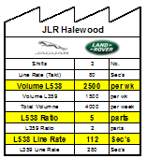
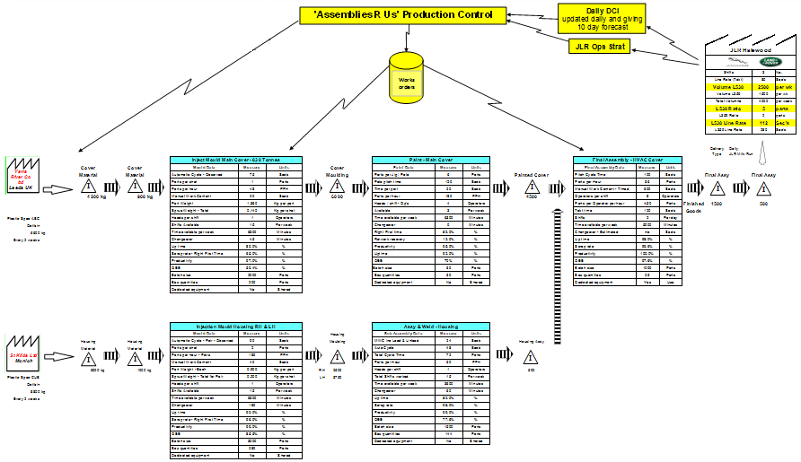
Value Stream Map
Customer Box - Symbols
Customer’s requirements:
Represent the customer with a factory icon
Box shows customer data
Factory Symbol – Indicates customers, suppliers, and outside manufacturing processes
Data Box Symbol – Summary of information for a process, customer, or department

Slide 21

Value Stream Map
Customer Box
Location | Solihull
No. of shifts | 3
Part name | ABC
Part number | 123
Volume:
Annual peak | 69308 | parts
Annual weekly | 1507 | parts
Flex | 10 | %
Aftermarket | 2 | %
Annual total | 77625 | parts
Weekly total | 1688 | parts
Customer's JPH | 15 | parts
Supplier’s JPH |  | parts
Customer's Takt Time |  | sec
Supplier’s Target Cycle Time |  | sec
“JPH” – Jobs per Hour
Build to Sequence

Slide 22
Value Stream Map
Customer Box
What is the value of “Supplier’s JPH”?
Same ?
Different ?
Why?
Location | Solihull
No. of shifts | 3
Part name | ABC
Part number | 123
Volume:
Annual peak | 69308 | parts
Annual weekly | 1507 | parts
Flex | 10 | %
Aftermarket | 2 | %
Annual total | 77625 | parts
Weekly total | 1688 | parts
Customer's JPH | 15 | parts
Supplier’s JPH | ??? | parts
Customer's Takt Time |  | sec
Supplier’s Target Cycle Time |  | sec
Notes:
- Ask delegates

Slide 23
Value Stream Map
Customer Box
What is the value of “Supplier’s JPH”?
OEE implications (here 85% assumed)
Location | Solihull
No. of shifts | 3
Part name | ABC
Part number | 123
Volume:
Annual peak | 69308 | parts
Annual weekly | 1507 | parts
Flex | 10 | %
Aftermarket | 2 | %
Annual total | 77625 | parts
Weekly total | 1688 | parts
Customer's JPH | 15 | parts
Supplier’s JPH | 18 | parts
Customer's Takt Time |  | sec
Supplier’s Target Cycle Time |  | sec
OEE = Overall Equipment Effectiveness (Performance)

Slide 24
Overall Equipment Effectiveness
Calculate OEE:
OEE
=
Availability
(%)
X
Performance
(%)
X
Quality
(%)
Quality % is the ratio of Good Parts against the number of Total Parts Produced
Quality % = Total Parts Made – Scrap Parts made in that Process
Total Parts Made
Scrap parts are reject parts that have to be re-made trough the original process
Scrap is assigned to the process that made the parts, such as casting, not where found, eg X-Ray
If re-work parts are put back through the original process, will be captured in the OEE performance calculation
If re-work parts are not put back through the process they are not included in OEE calculation

Slide 25
Rolled Throughput
Process input to account for scrap production:-
Question:
A process produces 40% scrap
Customer requirement is for 1,000 parts out of the process
How many parts must be input into the process to get 1,000 parts out with a 40% scrap?
a) 1,040
b) 1,667
c) 1,400
d) 1,440
The answer is b) 1,667
If you only add 40% to the volume required, the scrap in this addition 400 parts is not considered
The calculation is 1,000 / 0.6 (60% as a decimal)
Input parts = 1,000 / 0.6
= 1,667

Slide 26
Rolled Throughput
Rolled Throughput - can have a major impact on quantity of product required at each process
Calculation = P1% x P2% x P3% etc (Depending on the number or process steps) to get final RFT %
= 0.81 x 0.78 x 0.88 etc

Slide 27
Value Stream Map
Customer Box
What is “Takt Time”?
Location | Solihull
No. of shifts | 3
Part name | ABC
Part number | 123
Volume:
Annual peak | 69308 | parts
Annual weekly | 1507 | parts
Flex | 10 | %
Aftermarket | 2 | %
Annual total | 77625 | parts
Weekly total | 1688 | parts
Customer's JPH | 15 | parts
Supplier’s JPH | 18 | parts
Customer's Takt Time | ??? | sec
Supplier’s Target Cycle Time |  | sec

Slide 28
Value Stream Map
Customer Box
What is “Takt Time”?
“Takt” is German word for a precise interval of time such as a musical meter.
Location | Solihull
No. of shifts | 3
Part name | ABC
Part number | 123
Volume:
Annual peak | 69308 | parts
Annual weekly | 1507 | parts
Flex | 10 | %
Aftermarket | 2 | %
Annual total | 77625 | parts
Weekly total | 1688 | parts
Customer's JPH | 15 | parts
Supplier’s JPH | 18 | parts
Customer's Takt Time | ??? | sec
Supplier’s Target Cycle Time |  | sec
Takt Time is the speed with which the product needs to be produced in order to satisfy customer demand.

Slide 29
Value Stream Map
Customer Box
How to calculate “Takt Time”?
Location | Solihull
No. of shifts | 3
Part name | ABC
Part number | 123
Volume:
Annual peak | 69308 | parts
Annual weekly | 1507 | parts
Flex | 10 | %
Aftermarket | 2 | %
Annual total | 77625 | parts
Weekly total | 1688 | parts
Customer's JPH | 15 | parts
Supplier’s JPH | 18 | parts
Customer's Takt Time | ??? | sec
Supplier’s Target Cycle Time |  | sec

Slide 30
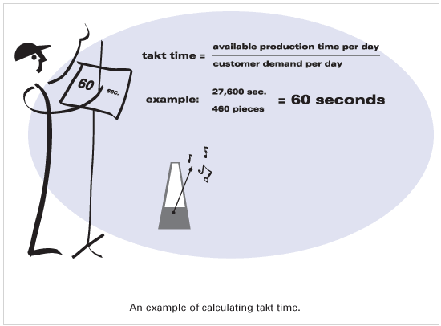
Value Stream Map
Customer Box
How to calculate “Takt Time”?
(week)
(week)
Location | Solihull
No. of shifts | 3
Part name | ABC
Part number | 123
Volume:
Annual peak | 69308 | parts
Annual weekly | 1507 | parts
Flex | 10 | %
Aftermarket | 2 | %
Annual total | 77625 | parts
Weekly total | 1688 | parts
Customer's JPH | 15 | parts
Supplier’s JPH | 18 | parts
Customer's Takt Time | ??? | sec
Supplier’s Target Cycle Time |  | sec
* https://www.lean.org/lexicon/takt-time

Slide 31
Value Stream Map
Customer Box
How to calculate “Customer’s Takt Time”?
Location | Solihull
No. of shifts | 3
Part name | ABC
Part number | 123
Volume:
Annual peak | 69308 | parts
Annual weekly | 1507 | parts
Flex | 10 | %
Aftermarket | 2 | %
Annual total | 77625 | parts
Weekly total | 1688 | parts
Customer's JPH | 15 | parts
Supplier’s JPH | 18 | parts
Customer's Takt Time | ??? | sec
Supplier’s Target Cycle Time |  | sec

Slide 32
Value Stream Map
Customer Box
How to calculate “Customer’s Takt Time”?
For traditional batch production and supply
Option 1: Use Volume (SCPA) and Time available
Location | Solihull
No. of shifts | 3
Part name | ABC
Part number | 123
Volume:
Annual peak | 69308 | parts
Annual weekly | 1507 | parts
Flex | 10 | %
Aftermarket | 2 | %
Annual total | 77625 | parts
Weekly total | 1688 | parts
Customer's JPH | 15 | parts
Supplier’s JPH | 18 | parts
Customer's Takt Time | ??? | sec
Supplier’s Target Cycle Time |  | sec
For build to sequence commodities
Option 2: Use JPH

Slide 33
Value Stream Map
Customer Box
How to calculate “Customer’s Takt Time”?
For traditional batch production and supply
Option 1: Use Volume (SCPA) and Time available
How to calculate Takt Time?
Location | Solihull
No. of shifts | 3
Part name | ABC
Part number | 123
Volume:
Annual peak | 69308 | parts
Annual weekly | 1507 | parts
Flex | 10 | %
Aftermarket | 2 | %
Annual total | 77625 | parts
Weekly total | 1688 | parts
Customer's JPH | 15 | parts
Supplier’s JPH | 18 | parts
Customer's Takt Time | ??? | sec
Supplier’s Target Cycle Time |  | sec
?
Option 2: Use JPH

Slide 34

Value Stream Map
Customer Box
How to calculate “Customer’s Takt Time”?
Option 1: Use Volume (SCPA) and Time available
Location | Solihull
No. of shifts | 3
Part name | ABC
Part number | 123
Volume:
Annual peak | 69308 | parts
Annual weekly | 1507 | parts
Flex | 10 | %
Aftermarket | 2 | %
Annual total | 77625 | parts
Weekly total | 1688 | parts
Customer's JPH | 15 | parts
Supplier’s JPH | 18 | parts
Customer's Takt Time | ??? | sec
Supplier’s Target Cycle Time |  | sec
$$Takt Time=\frac{Time available per Day}{Customer^{′}s demand per Day}$$
Option 2: Use JPH

Slide 35


Value Stream Map
Customer Box
How to calculate “Customer’s Takt Time”?
Option 1: Use Volume (SCPA) and Time available
$\text{Time} \text{Available} \text{per} \text{Shift} =\text{Total} \text{Time} \text{per} \text{Shift} −$ Breaks – Planned Downtime
$\text{Time} \text{Available} \text{per} Day =\text{Time} \text{Available} \text{per} \text{Shift} x$ No of Shifts
Location | Solihull
No. of shifts | 3
Part name | ABC
Part number | 123
Volume:
Annual peak | 69308 | parts
Annual weekly | 1507 | parts
Flex | 10 | %
Aftermarket | 2 | %
Annual total | 77625 | parts
Weekly total | 1688 | parts
Customer's JPH | 15 | parts
Supplier’s JPH | 18 | parts
Customer's Takt Time | ??? | sec
Supplier’s Target Cycle Time |  | sec
$$Takt Time=\frac{Time available per Day}{Customer^{′}s demand per Day} [sec]$$
$$\text{Customer}\text{’}\text{s} \text{demand} per Day=\frac{Customer′s demand per week}{\text{No} \text{of} \text{working} \text{days} \text{per} \text{week} }$$
Option 2: Use JPH

Slide 36


Value Stream Map
Customer Box
How to calculate “Customer’s Takt Time”?
Option 1: Use Volume (SCPA) and Time available
$\text{Time} \text{Available} \text{per} \text{Shift} =\text{Total} \text{Time} \text{per} \text{Shift} −$ Breaks – Planned Downtime
$\text{Time} \text{Available} \text{per} Day =\text{Time} \text{Available} \text{per} \text{Shift} x$ No of Shifts
Location | Solihull
No. of shifts | 3
Part name | ABC
Part number | 123
Volume:
Annual peak | 69308 | parts
Annual weekly | 1507 | parts
Flex | 10 | %
Aftermarket | 2 | %
Annual total | 77625 | parts
Weekly total | 1688 | parts
Customer's JPH | 15 | parts
Supplier’s JPH | 18 | parts
Customer's Takt Time | ??? | sec
Supplier’s Target Cycle Time |  | sec
$$Takt Time=\frac{Time available per Day}{Customer^{′}s demand per Day} [sec]$$
$$\text{Customer}\text{’}\text{s} \text{demand} per Day=\frac{Customer′s demand per week}{\text{No} \text{of} \text{working} \text{days} \text{per} \text{week} }$$
As a worked example we will use the following data:
Total Time per Shift = 480 mins
Breaks per Shift = 20 mins
Planned Downtime per Shift = 10mins
No of working days per week = 5
No of shifts per day = 3
Customer’s demand per day = (take data from the Customer’s box)
Option 2: Use JPH

Slide 37
Value Stream Map
Customer Box
How to calculate “Customer’s Takt Time”?
Option 1: Use Volume (SCPA) and Time available
$\text{Time} \text{Available} \text{per} \text{Shift} =\text{Total} \text{Time} \text{per} \text{Shift} −$ Breaks – Planned Downtime
$\text{Time} \text{Available} \text{per} Day =\text{Time} \text{Available} \text{per} \text{Shift} x$ No of Shifts
Location | Solihull
No. of shifts | 3
Part name | ABC
Part number | 123
Volume:
Annual peak | 69308 | parts
Annual weekly | 1507 | parts
Flex | 10 | %
Aftermarket | 2 | %
Annual total | 77625 | parts
Weekly total | 1688 | parts
Customer's JPH | 15 | parts
Supplier’s JPH | 18 | parts
Customer's Takt Time | ??? | sec
Supplier’s Target Cycle Time |  | sec
$$Takt Time=\frac{Time available per Day}{Customer^{′}s demand per Day} [sec]$$
$\text{Time} \text{Available} \text{per} \text{Shift} =480 mins−$ 20 $mins −10 mins=450 mins$
$\text{Time} \text{Available} \text{per} Day =450 mins x$ 3 Shifts = 1350 mins = 81000 sec
Option 2: Use JPH

Slide 38

Value Stream Map
Customer Box
How to calculate “Customer’s Takt Time”?
Option 1: Use Volume (SCPA) and Time available
Location | Solihull
No. of shifts | 3
Part name | ABC
Part number | 123
Volume:
Annual peak | 69308 | parts
Annual weekly | 1507 | parts
Flex | 10 | %
Aftermarket | 2 | %
Annual total | 77625 | parts
Weekly total | 1688 | parts
Customer's JPH | 15 | parts
Supplier’s JPH | 18 | parts
Customer's Takt Time | ??? | sec
Supplier’s Target Cycle Time |  | sec
$$Takt Time=\frac{81000 seconds per Day}{Customer^{′}s demand per Day}$$
$$\text{Customer}\text{’}\text{s} \text{demand} per Day=\frac{Customer′s demand per week}{\text{No} \text{of} \text{working} \text{days} \text{per} \text{week} }$$
$\text{Customer}\text{’}\text{s} \text{demand} per Day=\frac{1688}{\text{5}}$ = 338 parts per day
Option 2: Use JPH

Slide 39

Value Stream Map
Customer Box
How to calculate “Customer’s Takt Time”?
Option 1: Use Volume (SCPA) and Time available
Location | Solihull
No. of shifts | 3
Part name | ABC
Part number | 123
Volume:
Annual peak | 69308 | parts
Annual weekly | 1507 | parts
Flex | 10 | %
Aftermarket | 2 | %
Annual total | 77625 | parts
Weekly total | 1688 | parts
Customer's JPH | 15 | parts
Supplier’s JPH | 18 | parts
Customer's Takt Time | ??? | sec
Supplier’s Target Cycle Time |  | sec
$$Takt Time=\frac{81000 seconds per Day}{338 parts per Day}$$
Option 2: Use JPH

Slide 40
Value Stream Map
Customer Box
How to calculate “Customer’s Takt Time”?
Option 1: Use Volume (SCPA) and Time available
Location | Solihull
No. of shifts | 3
Part name | ABC
Part number | 123
Volume:
Annual peak | 69308 | parts
Annual weekly | 1507 | parts
Flex | 10 | %
Aftermarket | 2 | %
Annual total | 77625 | parts
Weekly total | 1688 | parts
Customer's JPH | 15 | parts
Supplier’s JPH | 18 | parts
Customer's Takt Time | 240 | sec
Supplier’s Target Cycle Time |  | sec
$$Takt Time=\frac{81000 seconds per Day}{338 parts per Day}$$
$$Takt Time=240 seconds$$
Option 2: Use JPH

Slide 41
Value Stream Map
Customer Box
How to calculate “Customer’s Takt Time”?
Option 1: Use Volume (SCPA) and Time available
Location | Solihull
No. of shifts | 3
Part name | ABC
Part number | 123
Volume:
Annual peak | 69308 | parts
Annual weekly | 1507 | parts
Flex | 10 | %
Aftermarket | 2 | %
Annual total | 77625 | parts
Weekly total | 1688 | parts
Customer's JPH | 15 | parts
Supplier’s JPH | 18 | parts
Customer's Takt Time | 240 | sec
Supplier’s Target Cycle Time |  | sec
What is the formula to calculate Takt Time using JPH?
For build to sequence commodities
Option 2: Use JPH
?

Slide 42

Value Stream Map
Customer Box
How to calculate “Customer’s Takt Time”?
Option 1: Use Volume (SCPA) and Time available
Location | Solihull
No. of shifts | 3
Part name | ABC
Part number | 123
Volume:
Annual peak | 69308 | parts
Annual weekly | 1507 | parts
Flex | 10 | %
Aftermarket | 2 | %
Annual total | 77625 | parts
Weekly total | 1688 | parts
Customer's JPH | 15 | parts
Supplier’s JPH | 18 | parts
Customer's Takt Time | 240 | sec
Supplier’s Target Cycle Time |  | sec
Option 2: Use JPH
$$Takt Time=\frac{3600 seconds}{\text{15} \text{Jo}bs per Hour}$$

Slide 43

Value Stream Map
Customer Box
How to calculate “Customer’s Takt Time”?
Option 1: Use Volume (SCPA) and Time available
Location | Solihull
No. of shifts | 3
Part name | ABC
Part number | 123
Volume:
Annual peak | 69308 | parts
Annual weekly | 1507 | parts
Flex | 10 | %
Aftermarket | 2 | %
Annual total | 77625 | parts
Weekly total | 1688 | parts
Customer's JPH | 15 | parts
Supplier’s JPH | 18 | parts
Customer's Takt Time | 240 | sec
Supplier’s Target Cycle Time |  | sec
Option 2: Use JPH
$$Takt Time=\frac{3600 seconds}{\text{15} \text{Jo}bs per Hour}=240 seconds$$
Notes:
- Mention the reality – these two not always match

Slide 44
Value Stream Map
Customer Box
How to calculate “Customer’s Takt Time”?
Option 1: Use Volume (SCPA) and Time available
Location | Solihull
No. of shifts | 3
Part name | ABC
Part number | 123
Volume:
Annual peak | 69308 | parts
Annual weekly | 1507 | parts
Flex | 10 | %
Aftermarket | 2 | %
Annual total | 77625 | parts
Weekly total | 1688 | parts
Customer's JPH | 15 | parts
Supplier’s JPH | 18 | parts
Customer's Takt Time | 240 | sec
Supplier’s Target Cycle Time |  | sec
$$Takt Time=\frac{81000 seconds per Day}{338 parts per Day}$$
$$Takt Time=240 seconds$$
Option 2: Use JPH
$$Takt Time=\frac{3600 seconds}{\text{15} \text{Jo}bs per Hour}=240 seconds$$
Notes:
- Mention the reality – these two not always match

Slide 45
Value Stream Map
Customer Box
What is the value of “Supplier’s Takt Time”?
Same ?
Different ?
Why?
Location | Solihull
No. of shifts | 3
Part name | ABC
Part number | 123
Volume:
Annual peak | 69308 | parts
Annual weekly | 1507 | parts
Flex | 10 | %
Aftermarket | 2 | %
Annual total | 77625 | parts
Weekly total | 1688 | parts
Customer's JPH | 15 | parts
Supplier’s JPH | 18 | parts
Customer's Takt Time | 240 | sec
Supplier’s Target Cycle Time | ??? | sec

Slide 46
Value Stream Map
Customer Box
What is the value of “Supplier’s Takt Time”?
OEE implications (here 85% assumed)
Location | Solihull
No. of shifts | 3
Part name | ABC
Part number | 123
Volume:
Annual peak | 69308 | parts
Annual weekly | 1507 | parts
Flex | 10 | %
Aftermarket | 2 | %
Annual total | 77625 | parts
Weekly total | 1688 | parts
Customer's JPH | 15 | parts
Supplier’s JPH | 18 | parts
Customer's Takt Time | 240 | sec
Supplier’s Target Cycle Time | 204 | sec
OEE = Overall Equipment Effectiveness (Performance)

Slide 47
Value Stream Map
Customer
Customer (JLR)

Slide 48
Value Stream Map – Information Flow
Customer - Plant Communications
Customer – Plant Communications

Slide 49
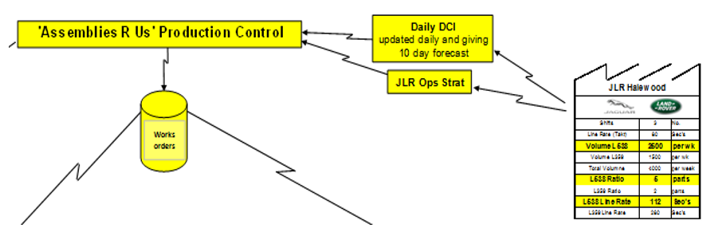

Value Stream Map – Information Flow
Customer - Plant Communications
TLS
Manual Information Flow – Use to indicate a manual production or shipping schedule.
Electronic Information Flow – Use to indicate electronic data exchange.
Forecast / Orders – Provides information on forecast and firm orders.
Informal Electronic Information Flow – Use to indicate email / fax / spreadsheet
Informal Manual Information Flow e.g. discussion, phone call
Orders

Slide 50
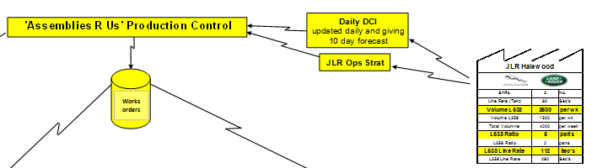
Value Stream Map – Information Flow
Customer - Plant Communications
TLS
What type of messages are received?
What is the frequency of the message?
What system is used to receive the message?
What is it used for?

Slide 51
Value Stream Map – Information Flow
Customer - Plant Communications
Customer – Plant Communications

Slide 52
Value Stream Map – Information Flow
Plant - Suppliers Communications
Plant – Suppliers Communications

Slide 53


Value Stream Map – Information Flow
Plant - Suppliers Communications
‘Assemblies R us’ Production Control
Weekly forecast EDI
Daily shipments requirement
Factory Symbol – Indicates customers, suppliers, and outside manufacturing processes
Data Box Symbol – Summary of information for a process, customer, or department
Manual Information Flow – Use to indicate a manual production or shipping schedule.
Electronic Information Flow – Use to indicate electronic data exchange.
Forecast / Orders – Provides information on forecast and firm orders.
Informal Electronic Information Flow – Use to indicate email / fax / spreadsheet
Informal Manual Information Flow e.g. discussion
Orders

Slide 54
Value Stream Map – Information Flow
Plant - Suppliers Communications
‘Assemblies R us’ Production Control
Weekly forecast EDI
Daily shipments requirement
How is the forecast communicated to the supplier base (automated system / email)?
What is the frequency of the communication?
What is the frequency of deliveries?
Indication of type and size of packaging

Slide 55
Value Stream Map – Information Flow
Plant - Suppliers Communications
Plant – Suppliers Communications

Slide 56
Value Stream Map – Information Flow
Plant – Production Planning
Plant – Production Planning

Slide 57
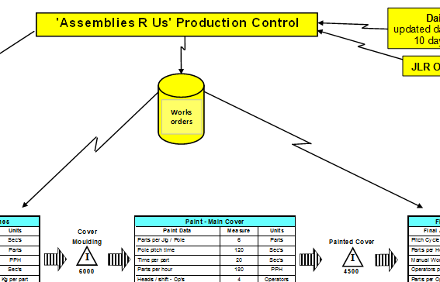
Value Stream Map – Information Flow
Plant – Production Planning
Production Control / Scheduling – indicates method of scheduling production (i.e. MRP)
Manual Information Flow – Use to indicate a manual production or shipping schedule.
Electronic Information Flow – Use to indicate electronic data exchange.
Informal Electronic Information Flow – Use to indicate email / fax / spreadsheet
Informal Manual Information Flow e.g. discussion

Slide 58
Value Stream Map – Information Flow
Plant – Production Planning
How is production scheduled / controlled?
What is used to send a message to production (email, MRP, printouts)?
How often information is sent out – once per shift, daily, weekly, monthly?
What is the feedback loop from shop floor to planning?

Slide 59
Value Stream Map – Information Flow
Plant – Production Planning
Plant – Production Planning

Slide 60
Value Stream Map – Process Flow
Process Flow
Process Flow

Slide 61
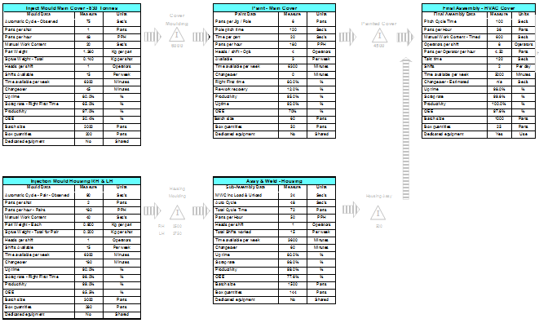
Value Stream Map – Process Flow
Process Flow
Data Box – Summary of information for a process, customer, or department
Gives an overview of all the process steps needed to deliver the end product
Depicts process flow
Provides detailed information on individual steps

Slide 62
Value Stream Map – Process Flow
Process Flow

Slide 63
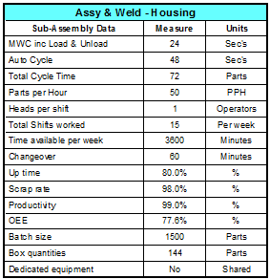
Value Stream Map – Process Flow
Process Step Box – Typical example
Process Step Name
Sec
Cycle Time Info
Sec
Sec
Output
Labour
Shifts and Time
(duration & no)
Efficiencies & running patterns
Box Q-ty
Dedicated / Shared (JLR %)
Detailed information on individual step

Slide 64
Value Stream Map – Process Flow
Process Step Box – Typical example
Process Step Name
Sec
Cycle Time Info
Sec
Sec
Output
Does this process meet the Takt Time?
Labour
Shifts and Time
Efficiencies & running patterns
Box Q-ty
Dedicated / Shared (JLR %)
Detailed information on individual step

Slide 65
Value Stream Map – Process Flow
Process Flow
Process Flow

Slide 66
Value Stream Map – Material Flow
Material Flow
Material Flow

Slide 67
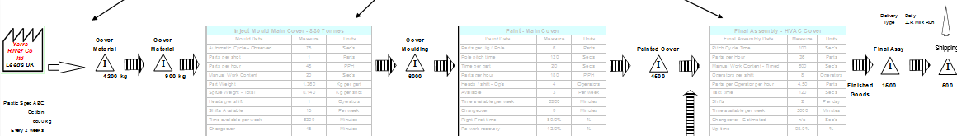
Value Stream Map – Material Flow
Material Flow - Symbols
Push Arrow – Production material that is produced and moved forward before the next process needs it.
Arrow – Used for movement of finished goods to the customer and raw material from the suppliers
FIFO –First In – First Out sequence. Maximum quantity is included.
Inventory – Count of inventory and time.
Truck Shipments – Indicates the type and frequency of shipments.
Buffer or Safety Stock – Accumulation of completed or partially complete assemblies and sub-assemblies.
Supermarket – A controlled inventory of parts that is used to schedule production at an upstream process. The open side faces towards the supplying process.

Slide 68
Value Stream Map – Material Flow
Material Flow
Shows the level of raw materials, inventory, Work In Process (WIP), and finished goods
Explains where material is stored and how it’s transported between process steps
Shows delivery frequency to the customer and Tier 2 suppliers

Slide 69
Value Stream Map – Material Flow
Material Flow
Tier 2 deliveries and
Raw materials storage
Inventory and Work in Process
Finished Goods
and
Shipment

Slide 70
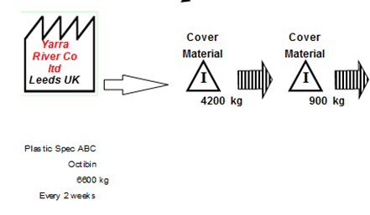
Value Stream Map – Material Flow
Material Flow
Tier 2 deliveries and
Raw materials storage
Name, location of a supplier
Deliveries frequency
Type of packaging / Q-ty of parts
Amount stored / Minimum stock level
Storage location area

Slide 71
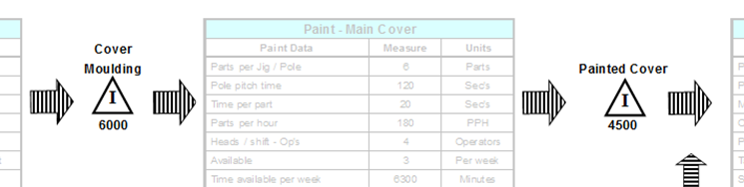
Value Stream Map – Material Flow
Material Flow
Inventory and Work in Process
Work in Process / Inventory
Stock levels
Space requirements
Method of storage
Movement between process steps

Slide 72
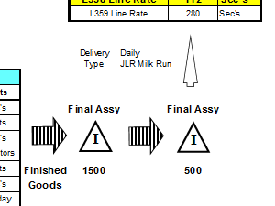
Value Stream Map – Material Flow
Material Flow
Finished Goods
and
Shipment
Finished goods storage
Amount stored / Minimum stock level
Location(s)
Frequency and type of deliveries to customer
Type of transport

Slide 73
Value Stream Map – Material Flow
Material Flow
Material Flow

Slide 74
Value Stream Map – Material Flow
Material Flow
Lead Time Analysis

Slide 75

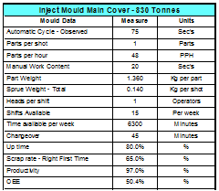
Lead Time
The time from when parts enter the process until they are finished goods
500
1030
770
300
Notes:
1

Slide 76
Lead Time
The time from when parts enter the process until they are finished goods
500
1030
770
300
Non Value Added
Value Added
Non-Value Added
Any activity / action that do NOT change a form, fit or function of the part and customer does not want to pay for i.e. walking, waiting, re-work, process delays, moving parts…
Value Added
Any activity / action that changes the shape or form of a product in line with customer requirements, that customer is willing to pay for and is done right first time i.e. Moulding, Casting, Welding, Painting, Assembly…
Notes:
1

Slide 77
Lead Time
The time from when parts enter the process until they are finished goods
500
1030
770
300
Non Value Added
Value Added
How to calculate Non-Value Added ?
Notes:
1

Slide 78

Lead Time
The time from when parts enter the process until they are finished goods
500
1030
770
300
Non Value Added
Value Added
$$\frac{number of parts in stock}{daily demand for the part }$$
Notes:
1

Slide 79
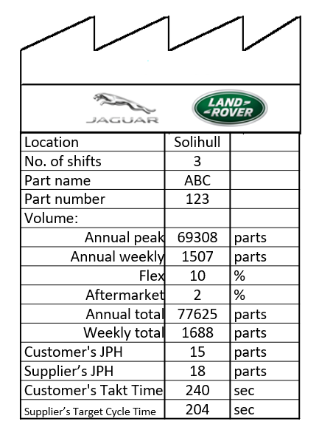
Lead Time
Using data from Customer Box calculate non-value added
The time from when parts enter the process until they are finished goods
500
1030
770
300
Non Value Added
Value Added
$$\frac{number of parts in stock}{daily demand for the part }$$
Notes:
1

Slide 80
Lead Time
Using data from Customer Box calculate non-value added
The time from when parts enter the process until they are finished goods
500
1030
770
300
Non Value Added
Value Added
$$\frac{number of parts in stock}{daily demand for the part }$$
Notes:
1

Slide 81

Lead Time
Using data from Customer Box calculate non-value added
The time from when parts enter the process until they are finished goods
500
1030
770
300
Non Value Added
Value Added
$$\frac{number of parts in stock}{daily demand for the part }$$
Notes:
1

Slide 82

Lead Time
Using data from Customer Box calculate non-value added
The time from when parts enter the process until they are finished goods
500
1030
770
300
Non Value Added
Value Added
$$\frac{number of parts in stock}{daily demand for the part }$$
= $\frac{500 parts}{ }$
Notes:
1

Slide 83
Lead Time
Using data from Customer Box calculate non-value added
The time from when parts enter the process until they are finished goods
500
1030
770
300
Non Value Added
Value Added
$$\frac{number of parts in stock}{daily demand for the part }$$
= $\frac{500 parts}{ }$
Notes:
1

Slide 84

Lead Time
Using data from Customer Box calculate non-value added
The time from when parts enter the process until they are finished goods
500
1030
770
300
Non Value Added
Value Added
$$\frac{number of parts in stock}{daily demand for the part }$$
= $\frac{500 parts}{ 337.6 parts per day}$
Notes:
1

Slide 85

Lead Time
Using data from Customer Box calculate non-value added
The time from when parts enter the process until they are finished goods
500
1030
770
300
Non Value Added
1.48 days
Value Added
$$\frac{number of parts in stock}{daily demand for the part }$$
= $\frac{500 parts}{337.6 parts per day}$
Notes:
1

Slide 86
Lead Time
The time from when parts enter the process until they are finished goods
500
1030
770
300
Non Value Added
1.48 days
3.05 days
2.28 days
0.88 days
Value Added
$$\frac{number of parts in stock}{daily demand for the part }$$
Notes:
1

Slide 87
Lead Time
The time from when parts enter the process until they are finished goods
500
1030
770
300
Non Value Added
1.48 days
3.05 days
2.28 days
0.88 days
Value Added
How to calculate Value Added ?
Notes:
1

Slide 88
Lead Time
The time from when parts enter the process until they are finished goods
500
1030
770
300
Non Value Added
1.48 days
3.05 days
2.28 days
0.88 days
Value Added
Cycle Times
Notes:
1

Slide 89
Lead Time
The time from when parts enter the process until they are finished goods
500
1030
770
300
Non Value Added
1.48 days
3.05 days
2.28 days
0.88 days
Value Added
65 sec
10 sec
60 sec
Cycle Times
Notes:
1

Slide 90
Lead Time
The time from when parts enter the process until they are finished goods
500
1030
770
300
Non Value Added
Total Non Value Added
1.48 days
3.05 days
2.28 days
0.88 days
Value Added
65 sec
10 sec
60 sec
Total Value Added
Total Non Value Added is the sum of all lead times within the stream
Total Value Added is the sum of all the value added processes through the main process
Notes:
1

Slide 91
Lead Time
The time from when parts enter the process until they are finished goods
500
1030
770
300
Non Value Added
Total Non Value Added
1.48 days
3.05 days
2.28 days
0.88 days
7.69 days
Value Added
65 sec
10 sec
60 sec
135 sec
Total Value Added
Notes:
1
- Normal in traditional batch manufacturing

Slide 92
Value Stream Map – Material Flow
Material Flow
Lead Time Analysis

Slide 93
Value Stream Map – Examples
Push vs Pull
“Push”
Supplier
Customer
Weekly: 6522
Demand/month:
Planning
Logistics
Part A = 4239
Part A =
6 months Flexi EDI
6 months Flexi EDI
Part B = 1630
Part B =
1 week fixed EDI
Part C = 652
Part C =
1 week fixed EDI
# of shifts = 3
# of shifts =
Daily build schedule
2 x/
week
2 x/
day
I
Fork Truck
I
6 Tns
3 Coils
Stamping
I
Welding
I
Assembly
I
Shipping
120 A
50 B
150 C
Fork Truck
C/T = 63 secs
C/O = 60 mins
Uptime = 100%
Scrap = 5%
Op / Shift = 1 / 3
150 A
100 B
100 C
C/T = 73 secs
C/O = 20 mins
Uptime = 95%
Scrap = 2%
Op / Shift = 1 / 3
1000 A
800 B
100 C
C/T = 110 secs
C/O = 60 secs
Uptime = 95%
Scrap = 8%
Op / Shift = 4 / 3
500 A
200 B
50 C
C/T = 40 secs
C/O = 10 secs
Uptime = 100%
Scrap = 0%
Op / Shift = 2 / 3
Fork Truck

Slide 94
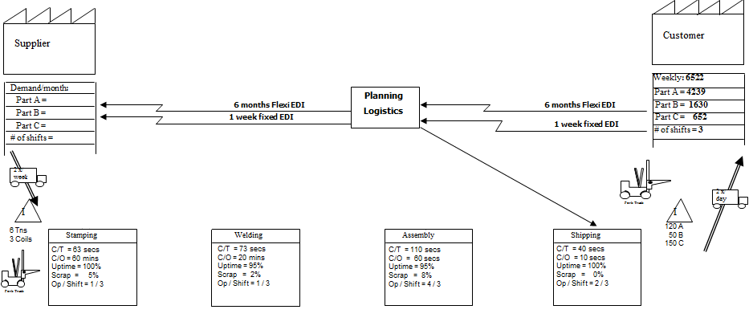
Value Stream Map – Examples
Push vs Pull
“Pull”
100
25
25

Slide 95
Value Stream Map – Examples
“Pull” symbols
“Pull”
Withdrawal – Indicates the pull of materials, usually from a supermarket.
Buffer or Safety Stock – Accumulation of completed or partially complete assemblies and sub-assemblies.
Supermarket – A controlled inventory of parts that is used to schedule production at an upstream process. The open side faces towards the supplying process.
Production Kanban – Card or device that gives permission to produce a product as well as the quantity of parts. Dotted line indicates kanban path.
Withdrawal Kanban – Card or device that instructs the material handler to get and transfer parts from a supermarket to a manufacturing process.
Signal Kanban – Signals when a point is reached and another batch needs to be produced. Used in a supplying process where changeovers are required.
Kanban Post or Collection Box – Place where kanbans are collected and held.

Slide 96
Value Stream Map
Areas of interest – What would you look for ?
Supplier
Customer
Weekly: 6522
Demand/month:
Planning
Logistics
Part A = 4239
Part A =
6 months Flexi EDI
6 months Flexi EDI
Part B = 1630
Part B =
1 week fixed EDI
Part C = 652
Part C =
1 week fixed EDI
# of shifts = 3
# of shifts =
Daily build schedule
Takt Time = 110 secs
2 x/
week
2 x/
day
I
Fork Truck
I
6 Tns
3 Coils
Stamping
I
Welding
I
Assembly
I
Shipping
120 A
50 B
150 C
Fork Truck
C/T = 63 secs
C/O = 60 mins
Uptime = 100%
Scrap = 5%
Op / Shift = 1 / 3
150 A
100 B
100 C
C/T = 73 secs
C/O = 20 mins
Uptime = 95%
Scrap = 2%
Op / Shift = 1 / 3
1000 A
800 B
100 C
C/T = 110 secs
C/O = 60 secs
Uptime = 95%
Scrap = 8%
Op / Shift = 4 / 3
500 A
200 B
50 C
C/T = 40 secs
C/O = 10 secs
Uptime = 100%
Scrap = 0%
Op / Shift = 2 / 3
Fork Truck

Slide 97
Value Stream Mapping – Symbols
Process – Each process box represents an area of flow. Label all processes. Also use for departments such as Production Control
Outside Sources – Indicates customers, suppliers, and outside manufacturing processes
Data Box – Summary of information for a process, customer, or department
Manual Information Flow – Use to indicate a manual production or shipping schedule.
Electronic Information Flow – Use to indicate electronic data exchange.
Operator – Represents the person working at a process.

Slide 98
Value Stream Mapping – Symbols
Inventory – Count of inventory and time.
Truck Shipments – Indicates the type and frequency of shipments.
Buffer or Safety Stock – Accumulation of completed or partially complete assemblies and sub-assemblies.
Supermarket – A controlled inventory of parts that is used to schedule production at an upstream process. The open side faces towards the supplying process.
Push Arrow – Production material that is produced and moved forward before the next process needs it.
Arrow – Used for movement of finished goods to the customer.

Slide 99
Value Stream Mapping – Symbols
FIFO – Transfer of controlled quantities between processes, First In – First Out sequence. Maximum quantity is included.
Withdrawal – Indicates the pull of materials, usually from a supermarket.
Informal Information Flow – eg discussion
Schedule – Represents time table for scheduling.
Load Levelling – System to intercept batches of kanban and level the volume and mix over a period of time.
Informal Electronic Information Flow – Use to indicate email / fax / spreadsheet
Go-See Scheduling – Adjusts schedules based on actually checking the inventory levels.

Slide 100
Value Stream Mapping – Symbols
Production Kanban – Card or device that gives permission to produce a product as well as the quantity of parts. Dotted line indicates kanban path.
Withdrawal Kanban – Card or device that instructs the material handler to get and transfer parts from a supermarket to a manufacturing process.
Signal Kanban – Signals when a point is reached and another batch needs to be produced. Used in a supplying process where changeovers are required.
Kanban Post or Collection Box – Place where kanbans are collected and held.
Kaizen Lightening Bursts – Brainstorming of ideas on the current state value stream map towards a vision for the future state map
Lead Time Icon – Indicates Value Added and Non-Value Added processing time.

Slide 101
Glossary
VSM – Value Stream Map
BTS – Build to Sequence
JPH – Jobs Per Hour
OEE – Overall Equipment Effectiveness
Op Strat – Operational Strategy
EDI – Electronic Data Interchange
TLS – Target Launch Sequence
MRP – Material Requirements Planning
FIFO – First In First Out
WIP – Work in Process

